Slide 1

Diagnosi precoce e campagne
di prevenzione nel melanoma
Vincenzo De Giorgi
Dipartimento di Scienze Dermatologiche
Università degli Studi di Firenze

Slide 2
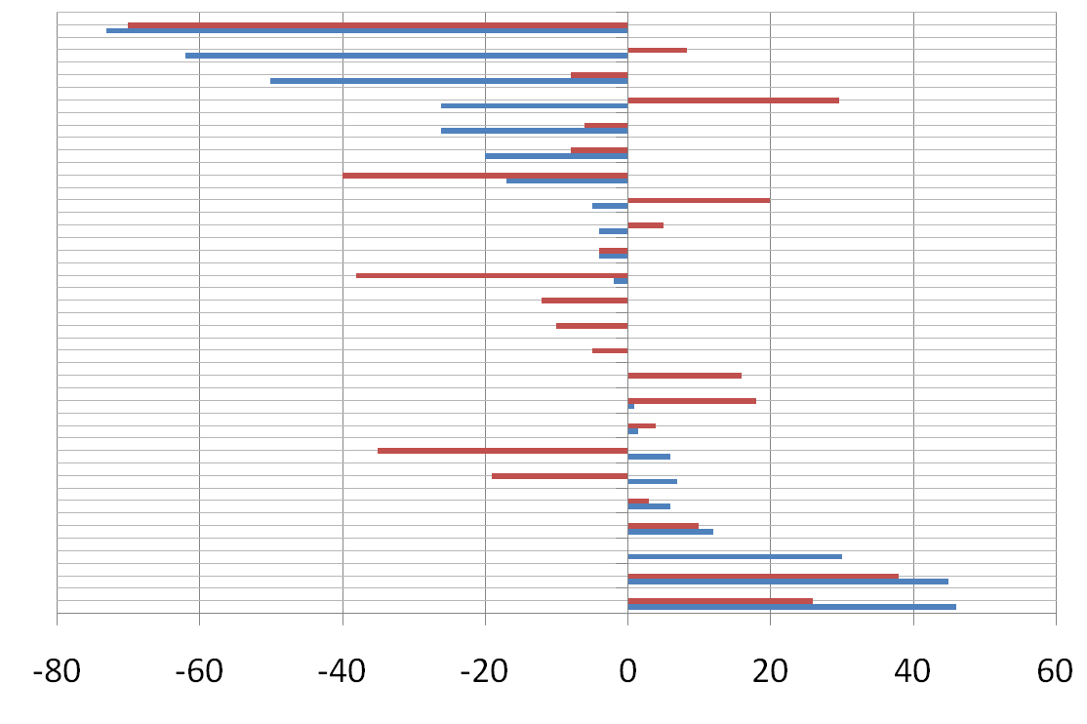
Registro Tumori della Regione Toscana.Cambiamento percentuale dell’incidenza 2003-2005 rispetto al 1993 – 1995,per sesso e principali sedi tumorali.
Stomaco
Laringe
Linfoma di Hodkin
Polmone
Leucemia
Esofago
Fegato
Cavita’ orale e faringe
Tutte le sedi
Colonretto
Mieloma
Ovaio
Utero,corpo
Cervice uterina
Mammella
Vescica
Pancreas
Vie biliari
Linfoma non
Rene
Cervello
Prostata
Tiroide
Melanoma
Donne
Uomini

Slide 3
epidemiologia descrittiva
Incidenza
-
tasso medio : circa 15 nuovi casi l’anno
x 100.000 (Australia : 40 x 100.000)
- da alcuni decenni : incremento di circa
5-7% annuo

Slide 4
incidenza
- sesso F : > arti inferiori
- sesso M : > tronco
sesso F : minore spessore medio
( diagnosi > precoce)
- sedi più’ facilmente esplorabili
- maggiore attenzione

Slide 5
In Italia 6500 nuovi casi ogni anno
3.5 ogni 100 nuovi tumori sono melanomi
25000 casi prevalenti (a 5 anni)
1600 decessi /anno
2 ogni 100 decessi per tumore
da: www.cspo.it

Slide 6
Regione toscana mortalità
4 decessi/anno ogni 100.000 abitanti
Circa 150 decessi/anno per melanoma
60% sesso maschile
40% sesso femminile
Notes:
Domanda 5 B Considerando proprio i dati della nostra regione abbiamo 4 decessi l’anno ogni 100000 abitanti. In particolare 150 decessi anno di cui il 60% del sesso maschile.

Slide 7
melanoma cutaneo:
sopravvivenza media a 5 anni
1960: circa 50%
2009: circa 90%
miglioramento DIAGNOSI PRECOCE ??????

Slide 8
Il Melanoma in Italia
I tumori in Italia – Rapporto 2006
http://www.registri-tumori.it

Slide 9
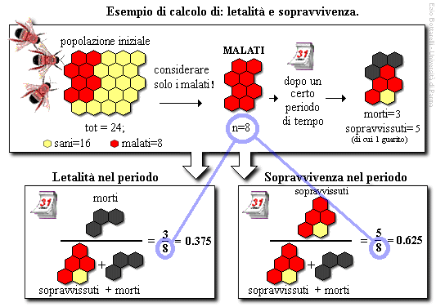

Slide 10
Regione toscana
- incremento circa 7% annuo
- analisi per classi di spessore::
incremento limitato a lesioni “sottili”
( < 0.75 - 1.00 mm)
- tassi incidenza lesioni “spesse” :
costanti nel tempo
(obiettivo: riduzione)

Slide 11
Crocetti E, Eur. J. Epidem. 2004
  Only superficial spreading melanoma is causing the melanoma epidemics ?
n.o.s
nodular
lentigo
ssm
acral l.m.
others
Tuscany Cancer Registry (Italy): incidence trends by histologic type 1985-1999

Slide 12
Crocetti E,
Eur. J. Epidem. 2004
n.o.s
nodular
lentigo
ssm
acral l.m.
others
Tuscany Cancer Registry (Italy): incidence trends by histologic type 1985-1999

Slide 13
L’aumento dell’ incidenza del melanoma riguarda solo le lesioni “sottili” (< 1 mm) e non si associa ad una diminuzione dell’incidenza delle lesioni “spesse”
Registro Toscano Tumori
Identificazione “selettiva” dei soggetti
ad alto rischio di melanoma “spesso”

Slide 14
Chamberlain AJ et al. Arch Dermatol 2002; 138: 609-14
“ Thick melanoma was predominantly nodular, occuring in older men…….
….. and associated with fewer nevi”

Slide 15
Nodular melanoma: patients’ perceptions of presenting features and implications for earlier detection
Chamberlain J et al JAAD 2003; 48:649-701
Compared to SSM, NMs are more often symmetric (80%), elevated (90%), uniform in color (78.1%), and non pigmented (61%)
Color change is uncommon (29% vs. 57%, p<0.05)
Nodular melanoma often fails to fulfill the ABCD diagnostic criteria

Slide 16
The excess of NMs detected by the patient
disappeared after adjustment for lesion’s thickness
NMs are more likely detected by the patient itself only when associated with late diagnosis (bleeding tumor)

Slide 17
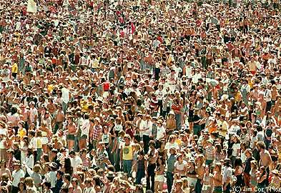
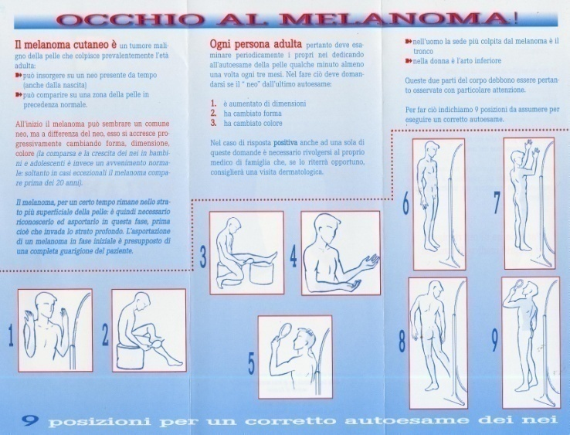
CAMPAGNE DI PREVENZIONE
MELANOMA
SCREENING DI MASSA
ABCDE E AUTOCONTROLLO

Slide 18
SCREENING DI MASSA
In a 3-year follow-up of almost
250 000 persons in the United States attending free skin cancer screenings by dermatologists, melanoma was diagnosed in 363
1.5 cases per 1000 individuals screened
Geller AC, Sober AJ, Zhang Z, et al. The American Academy of Dermatological National Skin Cancer Screening Program. Cancer. 2002;
95:1554-1561.

Slide 19
diagnosi precoce del Melanoma in Italia
Anni 80-90 : campagne educazione/prevenzione
in numerose aree geografiche
(Trento, Bergamo, Firenze, Roma, Modena,
Ancona, Viareggio, Bari ecc………)
“Skin Cancer Day”

Slide 20
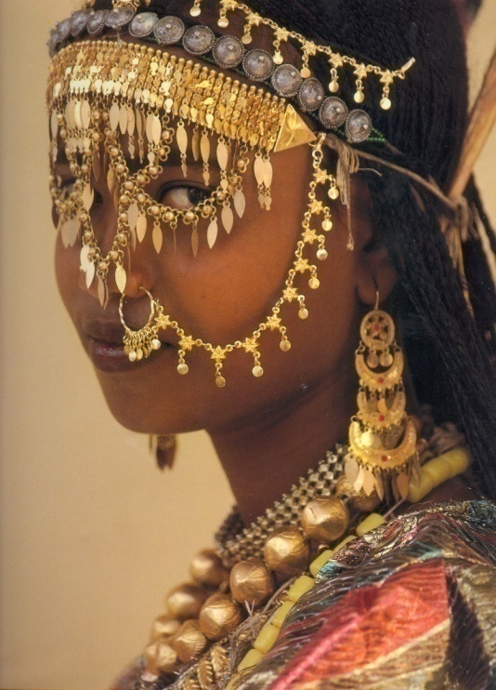
SIDEV - FederDerma
“evento mediatico”
accesso diretto:
Inevitabile “overload”
Skin Cancer Day 2000
2001
2002
2003/2008
accesso diretto/
Visite prenotate
Visite prenotate (URP)

Slide 21
Skin Cancer Day
(TV, giornali)
364 giorni l’anno
Educazione popolazione
(depliants, ecc.)
Formazione medici MG
(corsi, training, materiale)
Servizi dermatologici
Per la diagnosi precoce
“Pigmented Lesion Clinics”
Visite gratuite
Sedi temporanee

Slide 22
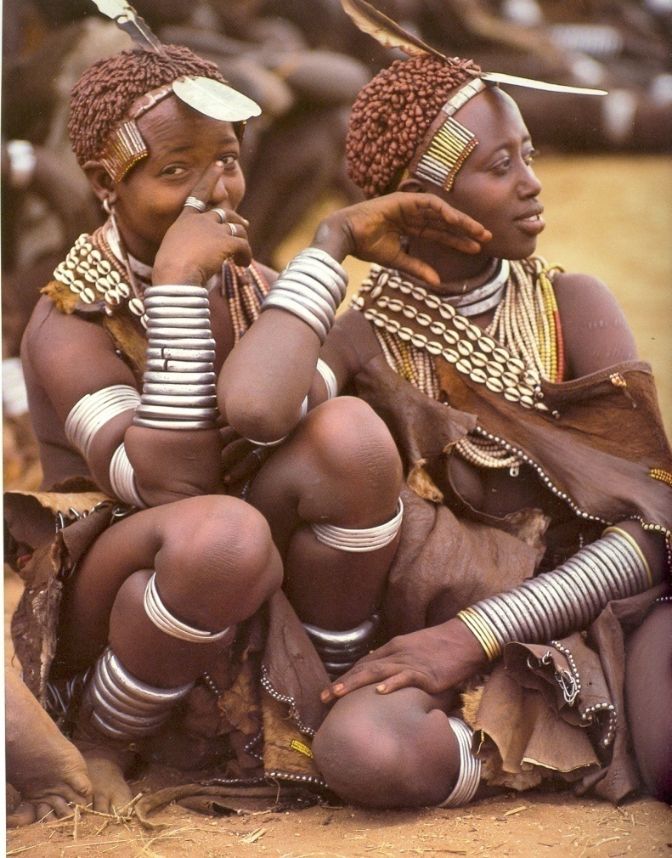
SKIN CANCER DAY 2008
(Firenze, May 8, 2008)
804 SUBJECTS
The examination was free of charge and no referral prescription from the family doctor was required.

Slide 23
SKIN CANCER DAY 2008
804 PATIENTS
Visit outcome | n | %
Melanoma | 0 | 0
Basal cell carcinoma | 12 | 1.5
Squamous cell carcinoma | 0 | 0
Suspicious lesions to biopsy | 24 | 3
Recommended follow-up (6,12 or 24 months) | 189 | 23.5
No risk factors | 507 | 63
No answer | 72 | 9

Slide 24
SKIN CANCER DAY 2008 804 SUBJECTS
This is the first dermatological visit that you effect for skin cancer prevention | % patients
yes | 18%
no | 59.5%
no answer | 22.5%
Early diagnosis for melanoma: is open access to skin cancer clinics really significant? A prospective study.
De Giorgi V, et al.
Preventive Medicine 2010;51(3-4):334-5

Slide 25
Number of common nevi | % patients
none | 10.5%
under 10 | 42%
da 11 a 30 | 23.5%
da 31 a 50 | 5%
over 50 | 4%
no answer | 15%
SKIN CANCER DAY 2008
804 SUBJECTS
RESULTS
Number of atypical nevi | % patients
none | 72.5%
</=5 | 27.5%
>5 | 0%

Slide 26
SKIN CANCER DAY IN ITALY
Men over 50 years are less responsive to prevention
programs accounting for less than 15% of all visits in
dermatological facilities during prevention initiatives.
Early diagnosis for melanoma: is open access to skin cancer clinics really significant? A prospective study.
De Giorgi V, et al.
Preventive Medicine 2010;51(3-4):334-5

Slide 27
melanoma prevention campaign
VS.
skin cancer clinics
American Academy of Dermatological National
Skin Cancer Screening Program
1.5 cases per 1000 individuals screened
European countries (UK, Italy..) :
collaboration between dermatologist
and family doctors (“filtering” process)
MM /visits ratio = 1: 22 - 1: 57
VS.
VS

Slide 28
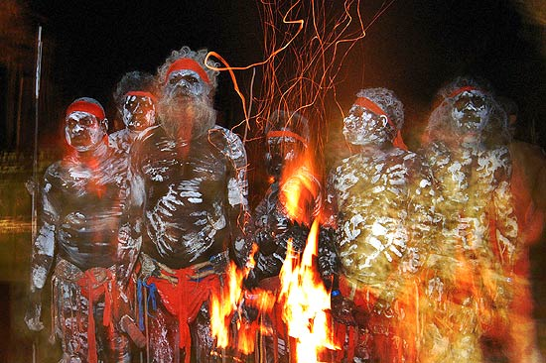
criticità
Pazienti già “seguiti”
Pazienti già “educati”

Slide 29
MELANOMA SCREENING
we must change the rather inefficient method of free voluntary screening and shift both economic and human resources to improve media coverage and communication campaigns whose aim is to inform the population and raise awareness about the importance of primary and secondary prevention of this very aggressive skin tumour.
Early diagnosis for melanoma: is open access to skin cancer clinics really significant? A prospective study.
De Giorgi V, et al.
Preventive Medicine 2010 Sep-Oct;51(3-4):334-5

Slide 30
CAMPAGNE DI PREVENZIONE
MELANOMA
SCREENING DI MASSA
ABCDE E AUTOCONTROLLO

Slide 31
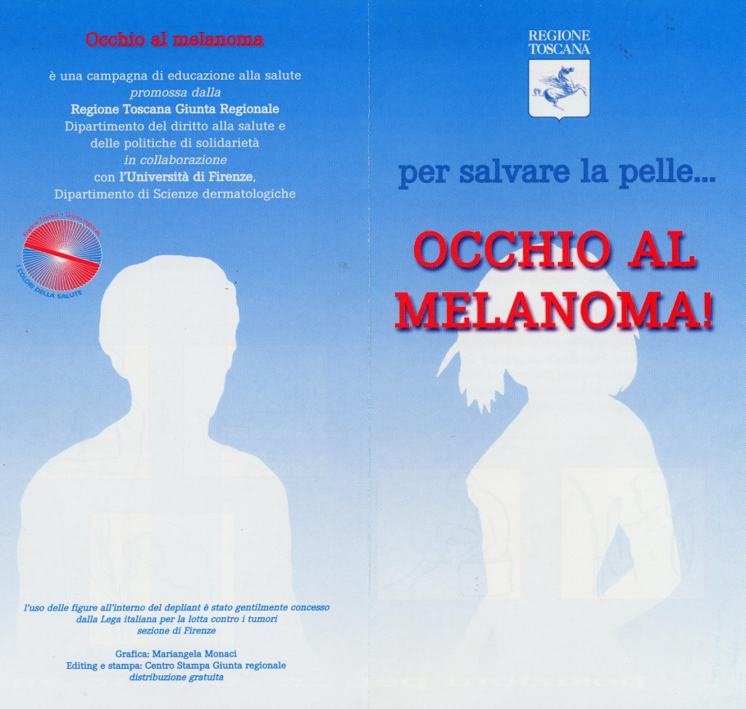

Is the self skin examination (ABCDE rules) still adequate in the “melanoma non invasive diagnosis era”?

Slide 32
ABCDE diagnostico
Asimmetria
Bordi
Colore
Dimensione >6mm
Evoluzione/Età

Slide 33
Is the self skin examination still adequate in the “melanoma non invasive diagnosis era”?
L’incidenza del melanoma è in costante crescita nelle ultime decadi.
una chiara diminuzione dello spessore medio di Breslow è stata evidenziata
…anche se…
la mortalità per melanoma è stabile
Garbe C. Melanoma epidemiology and trends.
Clin Dermatol. 2009 Jan-Feb;27(1):3-9

Slide 34
Is the self skin examination still adequate in the “melanoma non invasive diagnosis era”?
Lo spessore medio dei melanomi spessi e nodulari
è rimasto costante
Esiste uno ZOCCOLO DURO di popolazione che non è sensibile alle campagne di screening e prevenzione
Early diagnosis for melanoma: is open access to skin cancer clinics really significant? A prospective study.
De Giorgi V, et al . Preventive Medicine 2010;51(3-4):334-5
Notes:
34

Slide 35
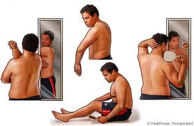
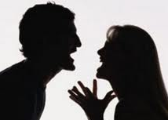

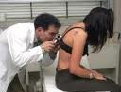
Is the self skin examination still adequate in the “melanoma non invasive diagnosis era”? A retrospective study
De Giorgi V, et al. British Journal of dermatology 2011, in press
Chi scopre il melanoma?
802 melanomi
Autocontrollo
Medico di famiglia
Familiare
Controllo Periodico dermatologico

Slide 36
Risultati
 |  | DETECTED
CHARATERISTICS | NUMBER | SELF-DETECTED | GP | FAMILY MEMBER | PERIODIC SKIN EXAMINATION
Total | 802 | 265 (33%) | 124 (15%) | 128 (16%) | 285 (36%)
Man | 385 (48%) | 96 (25%) | 58 (15%) | 78 (20%) | 153 (40%)
Woman | 417 (52%) | 169 (40%) | 66 (16%) | 50 (12%) | 132 (32%)
Age < 39 | 158 | 73 (46%) | 15 (10%) | 22 (14%) | 48 (30%)
Age 40 - 59 | 321 | 106 (33%) | 42 (13%) | 48 (15%) | 125 (39%)
Age > 60 | 323 | 86 (27%) | 67 (21%) | 58 (17%) | 112 (35%)
Education level < High school | 375 | 102 (27%) | 81 (22%) | 61 (16%) | 131 (35%)
Education level > High school | 427 (53%) | 163 (38%) | 43 (10%) | 67 (16%) | 154 (36%)
Positive Family history of melanoma | 85 (11%) | 25 (29%) | 9 (11%) | 21 (25%) | 30 (35%)
Positive personal history of melanoma | 56 (7%) | 15 (27%) | 7 (12%) | 5 (9%) | 29 (52%)

Slide 37
Risultati
 |  | DETECTED
CHARATERISTICS | NUMBER | SELF-DETECTED | GP | FAMILY MEMBER | PERIODIC SKIN EXAMINATION
Total | 802 | 265 (33%) | 124 (15%) | 128 (16%) | 285 (36%)
Man | 385 (48%) | 96 (25%) | 58 (15%) | 78 (20%) | 153 (40%)
Woman | 417 (52%) | 169 (40%) | 66 (16%) | 50 (12%) | 132 (32%)

Slide 38
Risultati
 |  | DETECTED
CHARATERISTICS | NUMBER | SELF-DETECTED | GP | FAMILY MEMBER | PERIODIC SKIN EXAMINATION
Total | 802 | 265 (33%) | 124 (15%) | 128 (16%) | 285 (36%)
Education level < High school | 375 | 102 (27%) | 81 (22%) | 61 (16%) | 131 (35%)
Education level > High school | 427 (53%) | 163 (38%) | 43 (10%) | 67 (16%) | 154 (36%)

Slide 39
Risultati
 |  | DETECTED
Breslow Thickness | NUMBER | SELF-DETECTED | GP | FAMILY MEMBER | PERIODIC SKIN EXAMINATION
Total | 802 | 265 (33%) | 124 (15%) | 128 (16%) | 285 (36%)
In Situ | 274 | 90 (33%) | 49 (17%) | 40 (15%) | 95 (35%)
1 mm or less | 404 | 129 (32%) | 55 (13%) | 71 (18%) | 149 (37%)
1.01 mm – 2.00 mm | 69 | 25 (36%) | 9 (13%) | 10 (15%) | 25 (36%)
2.01 mm – to 4.00 mm | 34 | 12 (35%) | 8 (24%) | 2 (6%) | 12 (35%)
Greater then 4.01 mm | 21 | 9 (43%) | 3 (14%) | 5 (24%) | 4 (19%)

Slide 40
Risultati
 |  | DETECTED
 | NUMBER Of SUBJECTS | SELF-DETECTED | GP | FAMILY MEMBER | PERIODIC SKIN EXAMINATION
Present Study 2011 | 802 | 33% | 15% | 16% | 36%
Carli et al. Clin Exp Dermatol. 2004 | 816 | 40.6% | 20.2% | 20.7% | 18.5%
Epstein et. JAMA 1999 | 102 | 55% | - | 22% | 24%
Kho et al. JAAD 1992 | 216 | 53% | - | 20% | 26%

Slide 41
Diminuzione dei melanomi scoperti per “self skin examination”
1992
53%
1999
55%
2004
40%
2010
33%
L’ AUTOCONTROLLO sembra non più efficace
rispetto ai decenni passati

Slide 42
Trend in crescita dei melanomi scoperti durante il controllo periodico
2010 36%
2002 18.5%

Slide 43
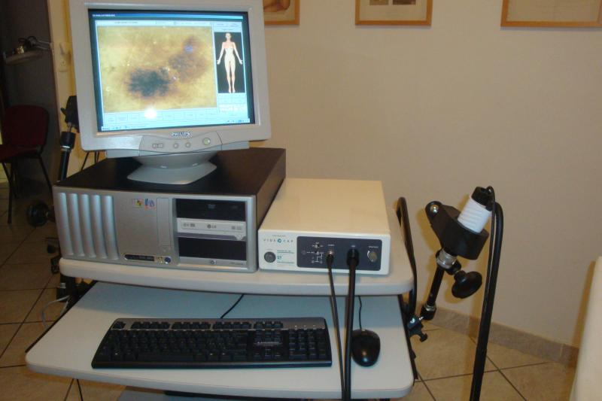
Diminuzione dei melanomi scoperti per “self skin examination”
Visita dermatologica di controllo periodico
miglioramento
Diagnosi precoce

Slide 44
ABCDE rule per l’autocontrollo delle lesioni pigmentate
Scopo: aiutare i pazienti e i medici non dermatologi a identificare lesioni potenzialmente sospette
Friedman RJ, Rigel DS, Kopf AW. Early detection of malignant melanoma: the role of physician examination and self-examination of the skin. CA Cancer J Clin. 1985 May-Jun;35(3):130-51.

Slide 45
ABCDE rule
Non è applicabile per i Melanomi Nodulari
I melanomi “piccoli” non rispondono ai criteri ABCDE
Rigel DS, Russak J, Friedman R. The evolution of melanoma diagnosis: 25 years beyond the ABCDs. CA Cancer J Clin. 2010 Sep-Oct;60(5):301-16

Slide 46
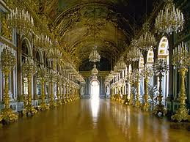
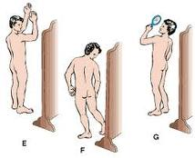
ABCDE rule
E’ ancora possibile chiedere ai pazienti di auto-controllarsi mediante un “gioco di specchi”?
De Giorgi V, et al. Is the self skin examination still adequate in the “melanoma non invasive diagnosis era”? A retrospective study. Br J Dermatol 2011. in press

Slide 47
ABCDE rule
305 casi | Testa collo | Tronco Anter. | Tronco Poster. | Arti infer. | Arti super. | Area genitale
Breslow Medio (mm) | 1,33 | 0,89 | 1,69 | 1,15 | 1,35 | 3,87
Is the self skin examination still adequate in the “melanoma non invasive diagnosis era”? A retrospective study
De Giorgi V, et al. British Journal of dermatology 2011, in press

Slide 48
Odd ratios for the probability of thick melanoma (>1mm)
Table 3. Odd ratios for the probability of thick melanoma (>1mm)
*Self-detection is compared to other methods, all grouped
**Variables included in the multivariate logistic model
when adjusting for gender and age at diagnosis with respect to the other detection methods (GP detection, family detection and periodic skin examination), self-detection was associated with a greater probability of having a thick melanoma and, therefore, a poor prognosis (OR 1.56).
Is the self skin examination still adequate in the “melanoma non invasive diagnosis era”? A retrospective study
De Giorgi V, et al. British Journal of dermatology 2011, in press

Slide 49
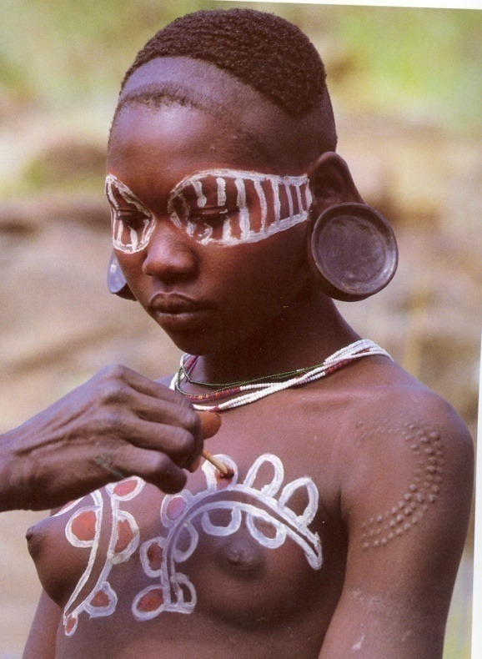
melanoma cutaneo :
diagnosi precoce
problema di rilevanza sociale
(“melanoma epidemic”)
b) esistenza di un esame diagnostico facilmente
eseguibile a basso costo, efficace, ben tollerato:
ispezione della cute / visita dermatologica
c) buona performance diagnostica
alta sensibilita’ / media specificita’ (simulatori)

Slide 50
melanoma cutaneo : diagnosi precoce
Identificazione “selettiva” dei soggetti ad alto rischio di melanoma “spesso”
“chiamata a visita” dermatologica
dei soggetti a rischio

Slide 51
COSTI MELANOMA
I costi per il trattamento del melanoma variano a seconda dello stadio della malattia
- 1732 $ per lo Stadio I
- 159808 $ per lo Stadio IV (per paziente)
I costi per il trattamento del melanoma in stadio avanzato sono 7 volte più alti dei costi delle campagna di prevenzione e della diagnostica non invasiva
Losina E, Wallensky RP, Geller A, et al.
“Visual screening for malignant melanoma. A cost-effectiveness analysis”
Arch Dermatol 2007; 143: 21-28

Slide 52
STRATEGY
PREVENTION:
PRIMARY = reduction of exposure to risk factors
POPULATION:
CHILDREN = aged between 10 and 14 years
MEN = aged between 40 and 65 years
Primary Schools
Secondary Schools

Slide 53
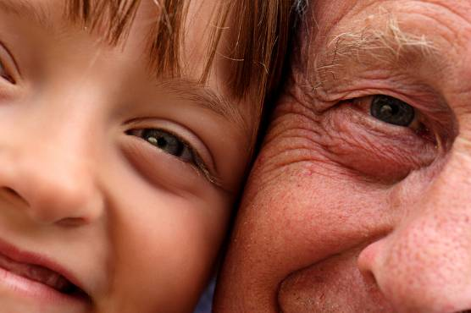
Sun Damage → Wrinkles
Too Much Sun!!!
Sun Protection
We get approximately 80% of our lifetime sun exposure before we are 18.20 years old.
Notes:
While wrinkles can occur naturally with age, the aging process is accelerated markedly by sun exposure during youth. Did you know that we get approximately 80% of our lifetime sun exposure before we even reach 18 years of age? The sun exposure we are getting today causes permanent damage that will largely dictate how our skin will look and feel throughout the rest of our lives.

Slide 54
Schematic diagram of changes
in sun protection with age
50+ yrs
n
30-49 yrs
20-29 yrs
n
14-19 yrs
n
n
Schofield et al 1993
Dixon et al 1997
Broadstock et al 1996
n
Hill et al 1993
3
-
4
5
-
1
1
1
2
-
1
7
1
4
p
l
u
s
a
g
e
/
y
r
s
Notes:
Primary Students Dixon H, Borland R & Hill D (1998)
Children’s sun protection attitudes & behaviours are generally positive in primary school but by mid primary wide-brimmed hats become less popular.
Tan motivation & sun burn increase with age.
Secondary Students Livingston P/ Broadstock
Livingston found 50% of students report they usually wear a hat on summer sunny days.
Broadstock found while attitudes to sun protection were generally positive so were attitudes to suntans
Transition to adulthood Schofield, Freeman et al
Some sun protection behaviour improves by early adulthood .
Males were more tanned, less likely to wear sunscreen & more likely to spend time outside.

Slide 55
INDOOR TANNING¹
Salon use in <25 year olds
  1996 - 8%; 2003 - 36%
College students: 42% – 55% usage rates
High school students
  Males 6 - 44%
  Females 30 – 70%
2001: Indoor tanning industry generated $4 billion in revenues
1 - Scientific and regulatory issues related to indoor tanning. JAAD 2004.
Notes:
These are data from a 2004 symposium organized by the FDA, the American Academy of Dermatology and the American Society for Photobiology. Tanning salon use by those ages 25 and under has increased dramatically.

Slide 56
iniziative
-
Scuole
Gazebo
Farmacie
Corsi formazione
Concerto
Aree ricreative

Slide 57
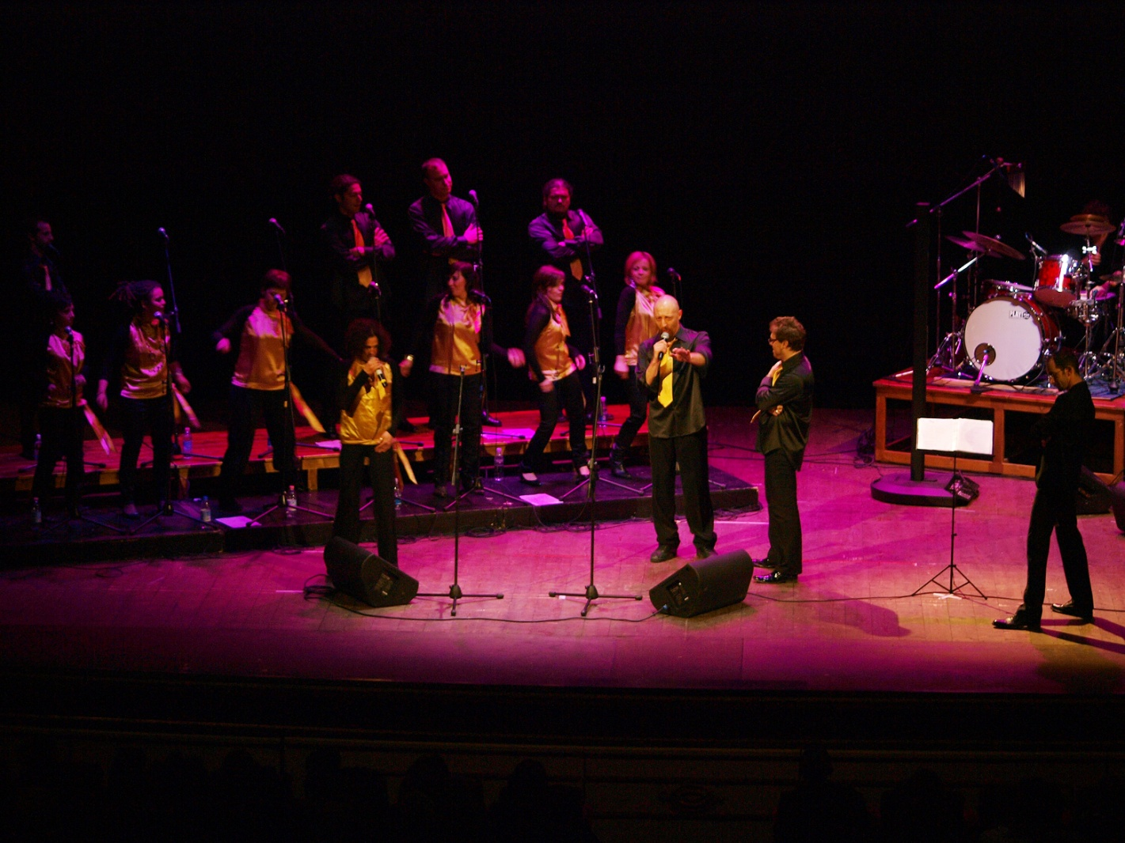
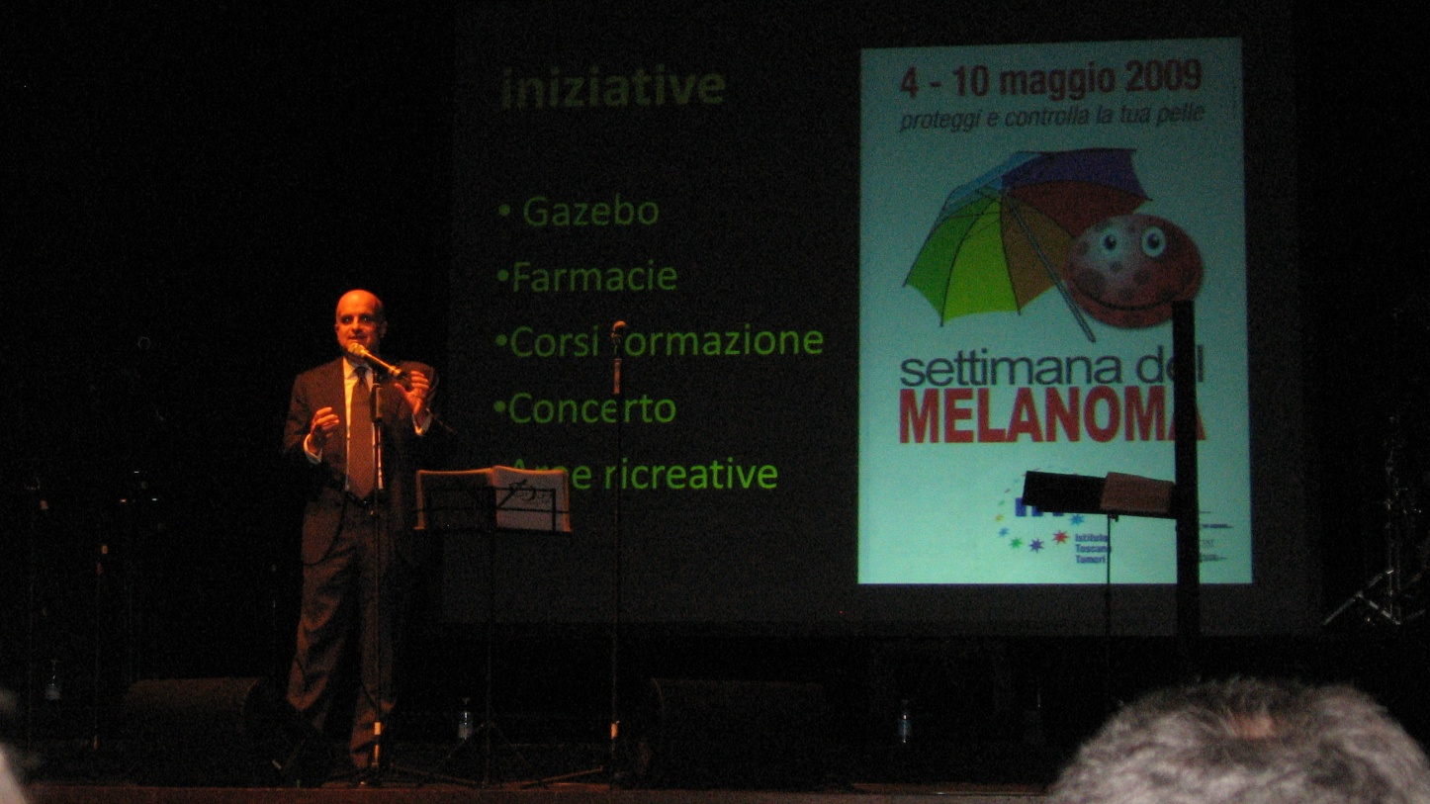

Slide 58
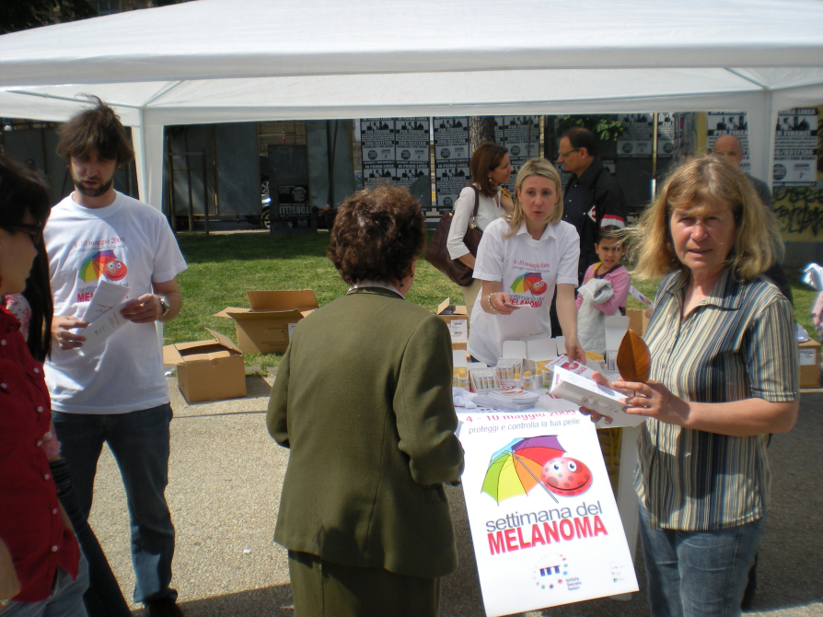
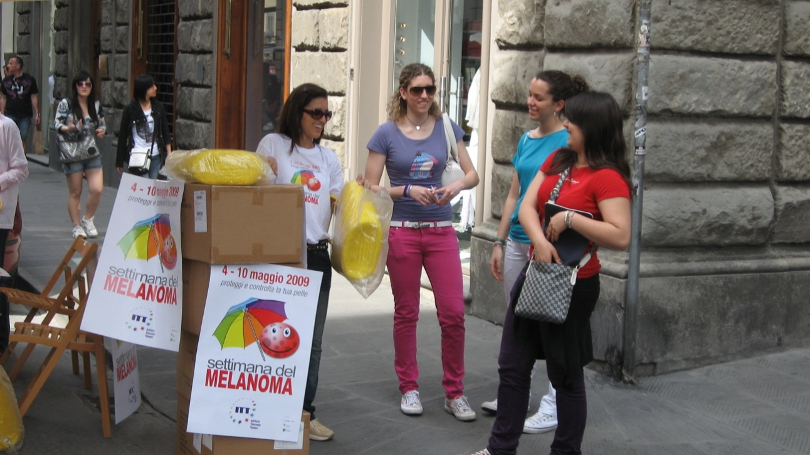
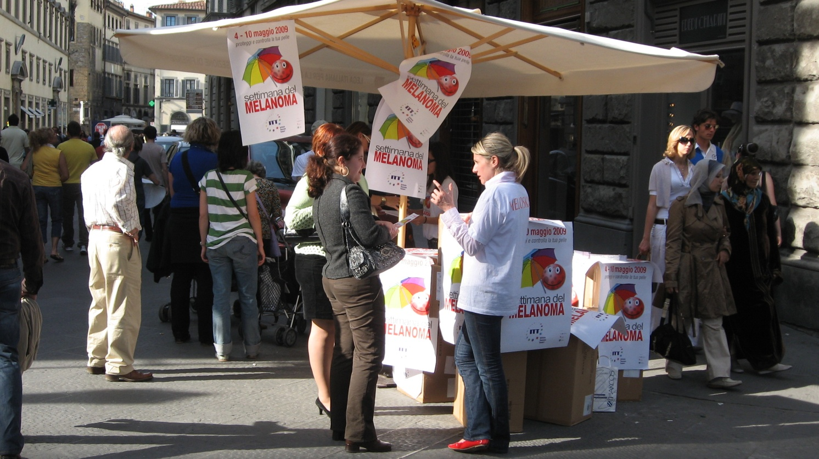

Slide 59
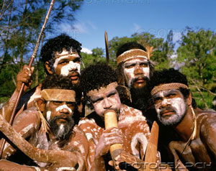
conclusioni
Educazione sanitaria popolazione:
Strategia nazionale
Diagnosi precoce:
Strategia nazionale/locale
Strategia regionale
  Ottimizzazione attivita’
  (informazione / formazione medici di famiglia)

Slide 60
GOAL
Modificare e /o associare il messaggio
Educativo da “ skin self-examination” a
“controllo dermatologico annuale”
raggiungere target meno sensibili :
sesso maschile fra i 40 e 60 anni
ricerca “attiva” durante visita per altri
motivi (sia medica che dermatologica)

