Slide 1
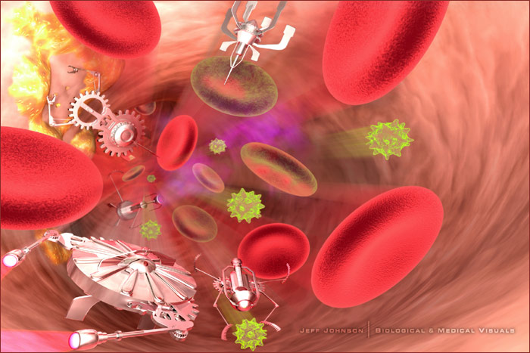
Novità in tema di aterotrombosi
Il trattamento ottimale
della sindrome coronarica acuta
Ospedale San Giovanni di Dio
3 ottobre 2009
Loreno Querceto

Slide 2
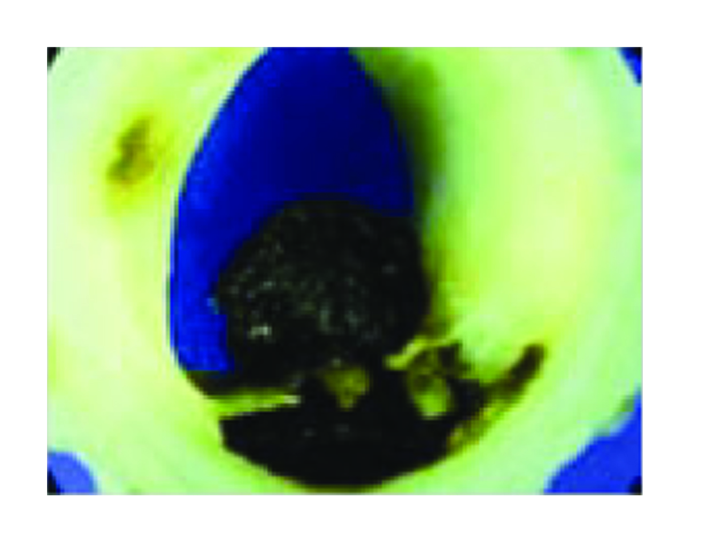
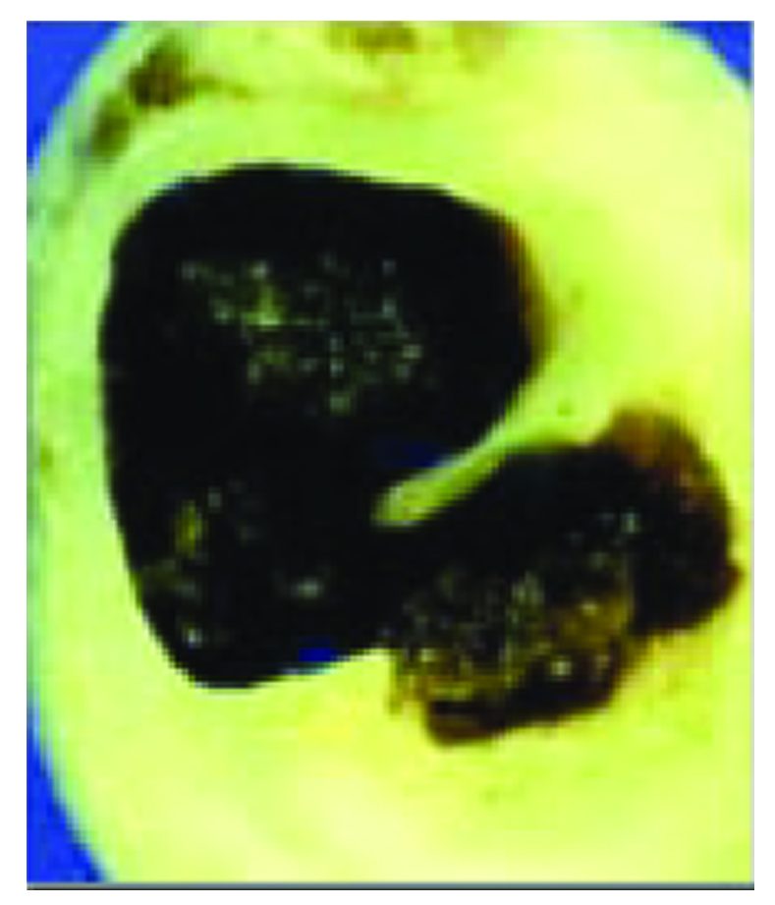
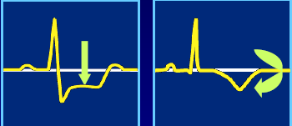
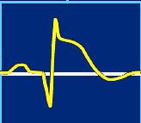
Acute Coronary Syndrome
No ST Elevation
ST Elevation
Inhibit platelet aggregation to prevent progression of thrombosis
Restore blood flow as soon as possible
Therapeutic goal

Slide 3
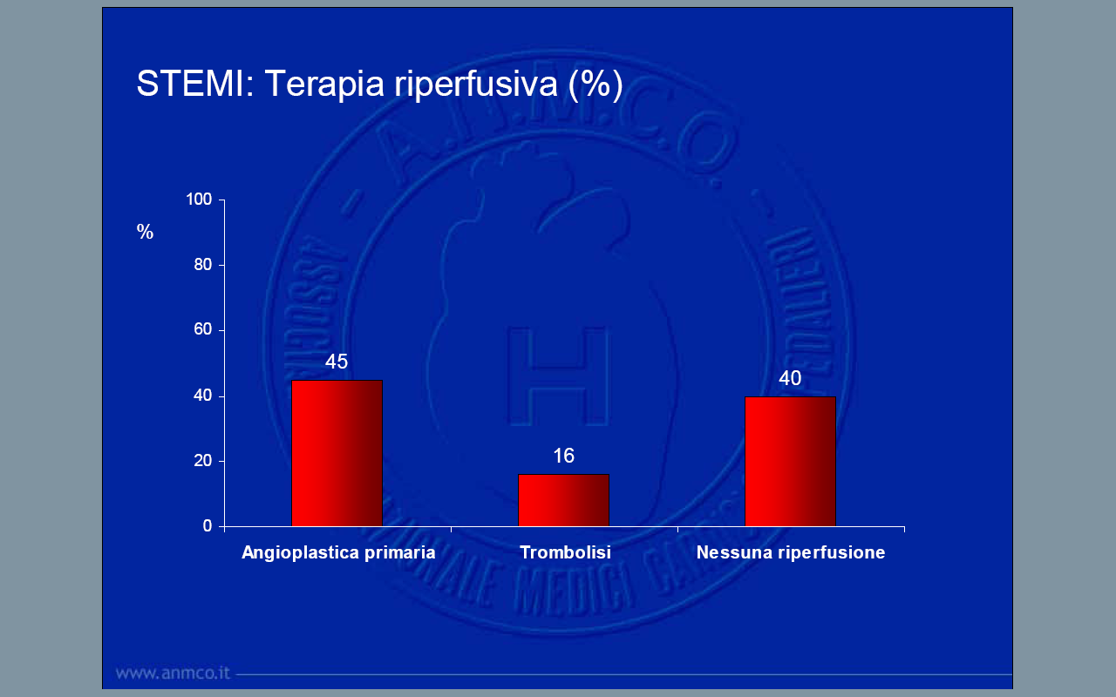
BLITZ 3
ANMCO 2008

Slide 4
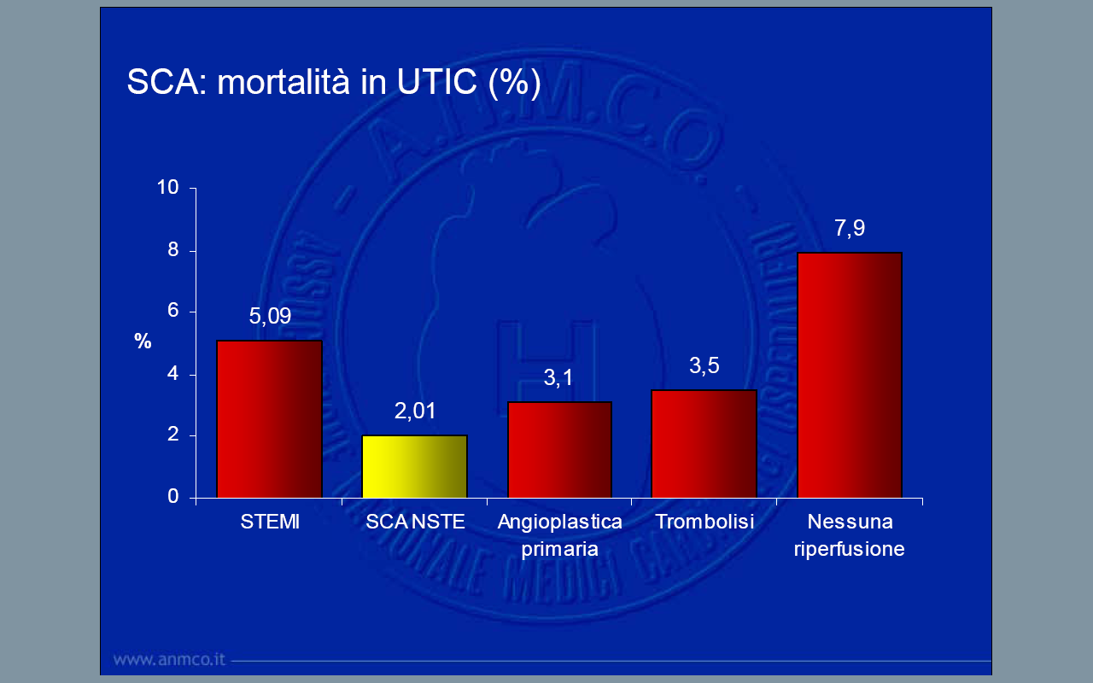
BLITZ 3
ANMCO 2008

Slide 5
The New 2008 ESC STEMI Guidelines
Primary PCI

Slide 6
Time Delay to treatment and Mortality in PPCI
Every 30 min delay is associated with a relative increase of 7.5% in 1-year mortality
1-year mortality
De Luca G et al. Circulation 2004; 109:1223

Slide 7
PCI vs Lysis: Importance of Timing
15
10
5
0
–5
For every 10 min delay to PCI:
1% reduction in Mortality Diff
P = 0.006
N = 7419
Absolute Risk Difference in Death, %
Favors PCI
Favors Fibrinolysis
0 | 20 | 40 | 60 | 80 | 100
PCI-Related Time Delay, min.
Nallamothu and Bates, AJC, 2003.
Notes:
Second, the mortality benefit associated with primary percutaneous coronary intervention in ST-segment elevation myocardial infarction may be lost if door-to-balloon time is delayed by >1 hour as compared with fibrinolytic therapy door-to-needle time. Interventional cardiology laboratories endeavoring to achieve the benefits of primary percutaneous coronary intervention seen in randomized clinical trials should aim to match their short door-to-balloon times

Slide 8
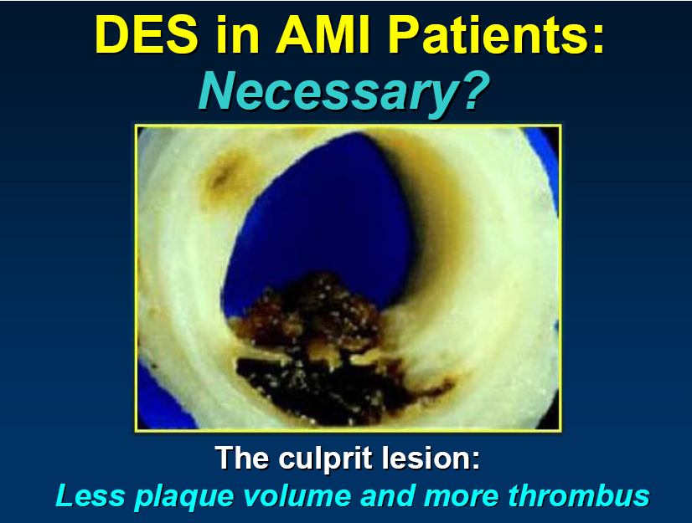

Slide 9
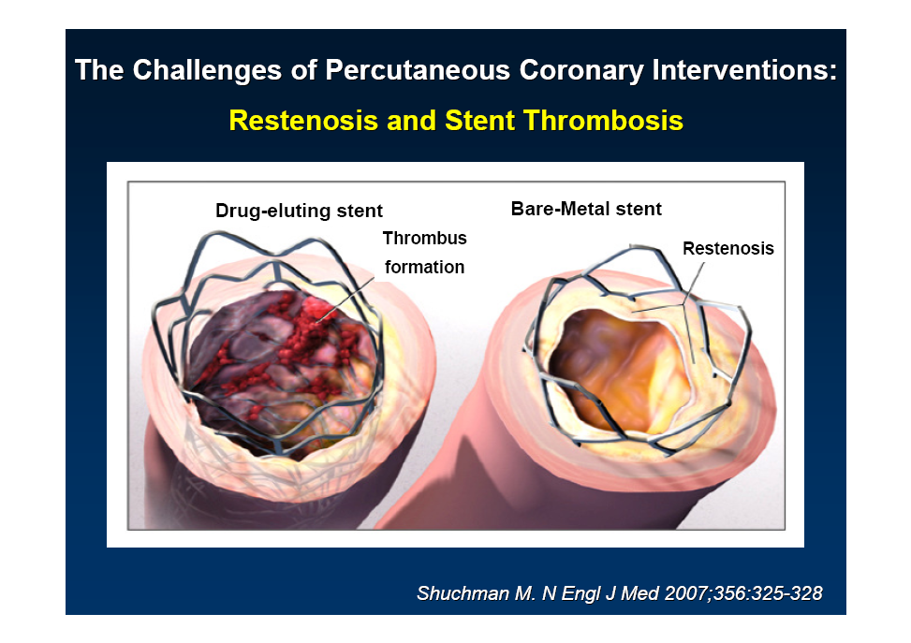
DES in STEMI
Restenosis or Stent Thrombosis ?

Slide 10
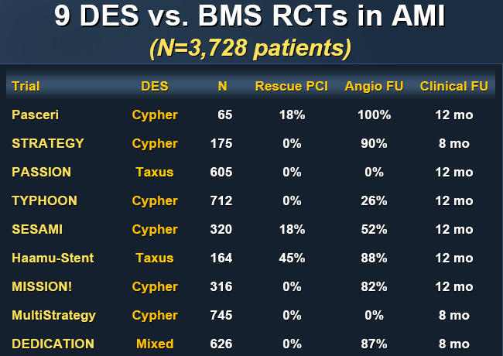
DES in STEMI

Slide 11
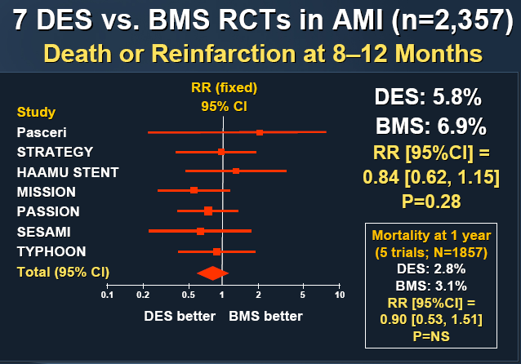
DES in STEMI

Slide 12
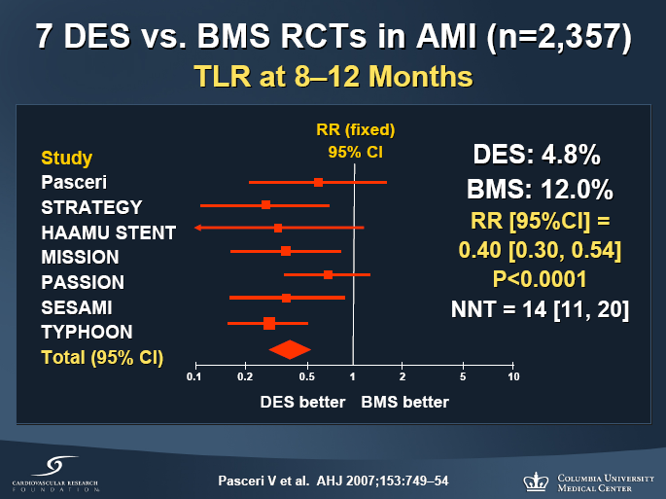
DES in STEMI

Slide 13
HORIZONS-AMI Stent
Trial design: Patients presenting within 12 hours with a STEMI were randomized in a 3:1 fashion to receive either PES or BMS. Clinical outcomes were compared at 12 months.
Results
(p = 0.01)*
(p = 0.77)
Significant ↓ in ischemia-driven target lesion revascularization (TLR) in the PES arm (4.5% vs. 7.5%, HR 0.59, 95% CI 0.43-0.83, p = 0.002)
PES noninferior to BMS in the incidence of MACE (p for noninferiority = 0.01)
Mortality (p = 0.98), stent thrombosis (p = 0.77), and MI (p = 0.31) similar between the two arms; angiographic restenosis lower with PES (p < 0.001)
20
20
15
15
%
%
10
8.1
8.0
10
5
5
3.2
3.4
Conclusions
0
0
MACE
Stent thrombosis
DES superior to BMS in reducing restenosis and TLR at 1 year in patients with STEMI
Mortality, stent thrombosis rates similar
PES
(n = 2,257)
BMS
(n = 749)
* For noninferiority
Stone GW, et al. NEJM 2009;360:1946-59

Slide 14
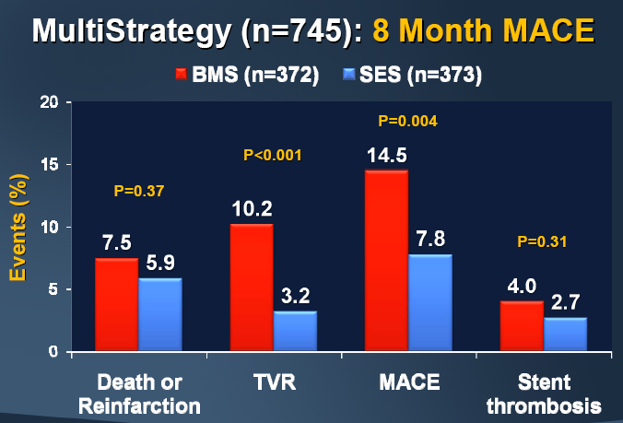
DES in STEMI

Slide 15
DES in STEMI
DES in STEMI is feasible, safe and effective
but
Rapid restoration of blood flow in PPCI in more important than the reduction of restenosis
In PPCI may be difficult to rule out circumstances limiting the long term use of clopidogrel
In STEMI clopidogrel can’t be prescribed for a long time
but

Slide 16
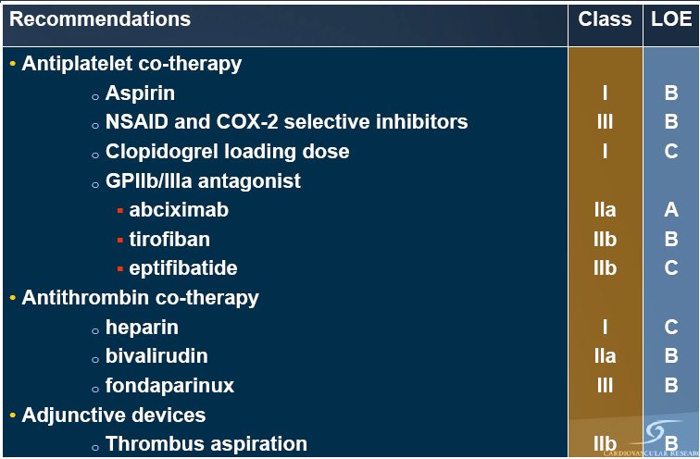
The New 2008 ESC STEMI Guidelines
Adjunctive therapy Primary PCI
Notes:
Un efficace trattamento anti-piastrinico è fondamentale per il buon esisto di una pPCI

Slide 17
Meta-analysis: Facilitated PCI vs
Primary PCI
Mortality
Reinfarction
Major Bleeding
Lytic alone N=2953
IIb/IIIa alone N=1148
Lytic +IIb/IIIa N=399
All (N=4500)
1.43
(1.01-2.02)
1.81 (1.19-2.77)
1.03
(0.49-2.17)
1.40 (0.49-3.98)
3.07
(0.18-52.0)
1.03
(0.15-7.13)
1.38
(1.01-1.87)
1.71
(1.16 - 2.51)
1.51
(1.10 - 2.08 )
0.1
1
10
0.1
1
10
0.1
1
10
Fac. PCI
Better
PPCI
Better
Fac. PCI
Better
PPCI
Better
Fac. PCI
Better
PPCI
Better
Keeley E, et al. Lancet.
Notes:
Non sono raccomandate cosiddette facilitazioni: Pretrattamenti con fibrinolitici da soli ad insieme ad inib IIb-IIIa aumentano solo i rischi di sanguinamnto

Slide 18
The New 2008 ESC STEMI Guidelines
Adjunctive therapy Primary PCI
Not recommended:
Upstream therapy with GPI,
fibrinolytics or the combination

Slide 19
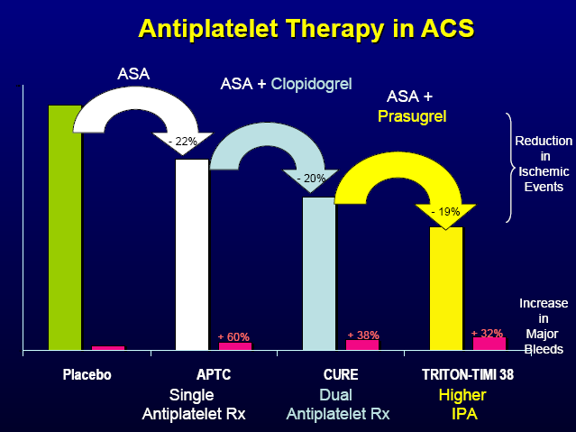

Slide 20
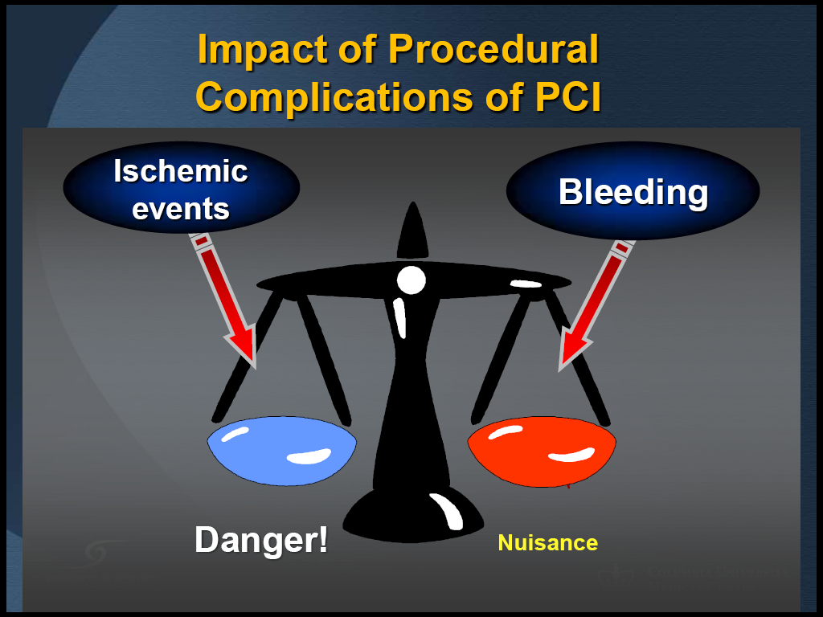
Bleeding in ACS
Ischemic and bleeding events have the same impact on mortality risk in ACS pts undergoing PCI

Slide 21
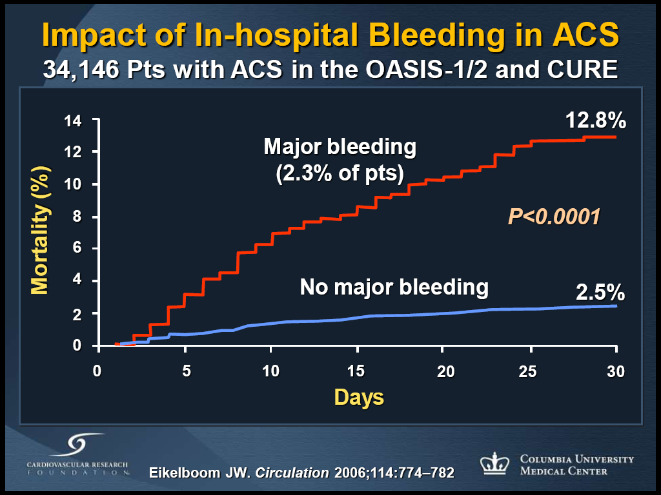
Bleeding in ACS

Slide 22
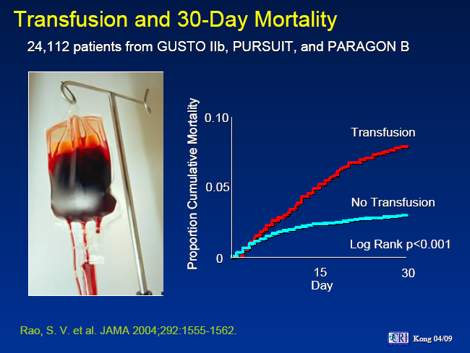
Bleeding in ACS

Slide 23
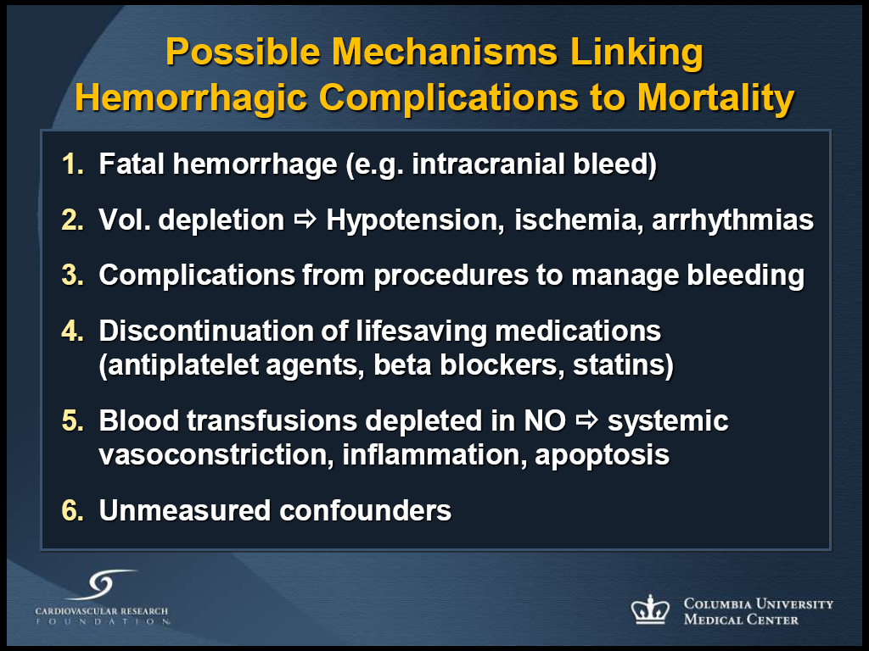
Bleeding in ACS

Slide 24
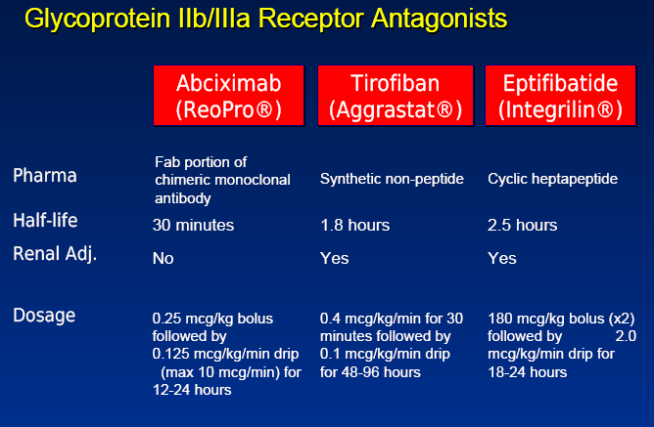
Gp IIb-IIIa INHIBITORS in STEMI

Slide 25
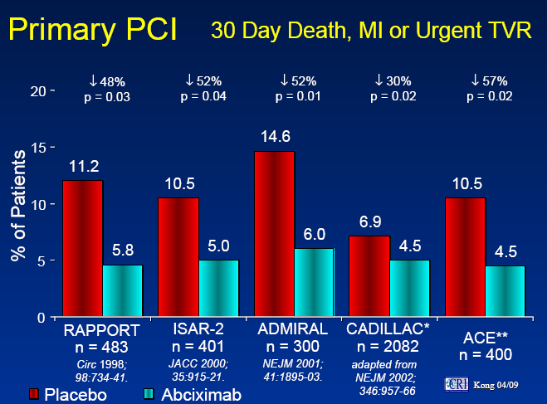
Gp IIb-IIIa INHIBITORS in STEMI

Slide 26
ClinicalTrials.gov Identifier: NCT00133250
Abciximab in Patients with AMI Undergoing Primary PCI After Clopidogrel Pretreatment
BRAVE-3 Trial
Bavarian Reperfusion AlternatiVes Evaluation-3 Trial
J. Mehilli, A. Kastrati, K. Huber, S. Schulz, J. Pache, C.Markwardt, S. Kufner, F. Dotzer, K. Schlotterbeck,
J. Dirschinger, A. Schömig

Slide 27
BRAVE-3 Trial
Study Therapy
(randomized, double-blind)
Clopidogrel 600 mg oral
Aspirin 500 mg i.v. or oral
Unfractionated Heparin 5000 IU
Abciximab
n=401
Bolus: 0.25 mg/kg
Infusion: 0.125 μg/kg/min/12h
Placebo
n=399
Additional UFH bolus of 70U/kg
Placebo infusion for 12h
Aspirin 200mg/day indefinitely
Clopidogrel 2 x 75mg/day for 3 days
Clopidogrel 75mg/day for at least 4 weeks

Slide 28
BRAVE-3 Trial
Primary Endpoint: infarct size
Final infarct size
Mean
Final infarct size
Median [25th; 75th percentile]
P = .47
40
P =.76
% LV
% LV
30
20
10
10
9
Abciximab
Placebo
0
Abciximab
Placebo

Slide 29
BRAVE-3 Trial
30-Day Mortality
6
P = .53
%
4
Abciximab
Cumulative Incidence
Placebo
2
0
0
5
10
15
20
25
30
Days after randomization

Slide 30
BRAVE-3 Trial
Clinical Adverse Events - 30 days -
6
P = .99
P = .09
P = .03
%
4
Bleeding
3.7
Thrombocytopenia
2
1.8
1.8
1.8
1.5
0
0
TIMI major
TIMI minor
<20,000/µl
Abciximab
Placebo

Slide 31
BRAVE-3 Trial
Conclusion
In patients with acute STEMI undergoing primary PCI after pre-treatment with a 600mg loading dose of clopidogrel, the additional use of abciximab is not associated with further reduction in infarct size

Slide 32
The New 2008 ESC STEMI Guidelines
Adjunctive therapy Primary PCI

Slide 33
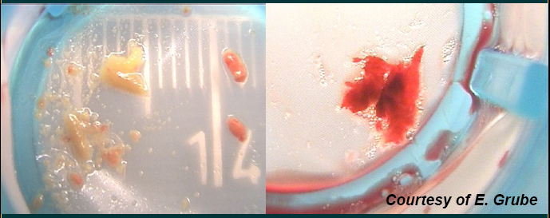
Distal Embolisation

Slide 34
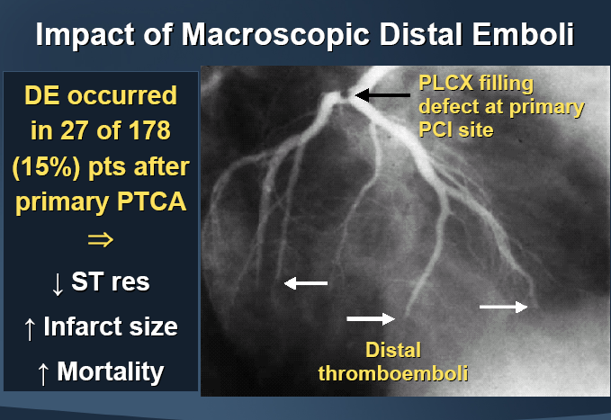
Distal Embolisation

Slide 35
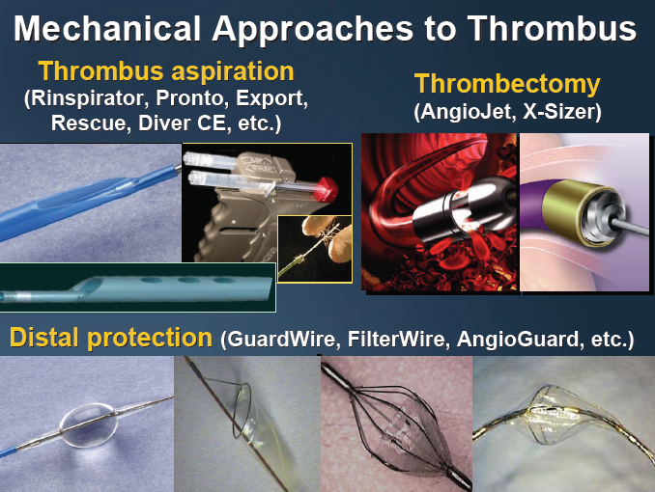
Distal Embolisation

Slide 36
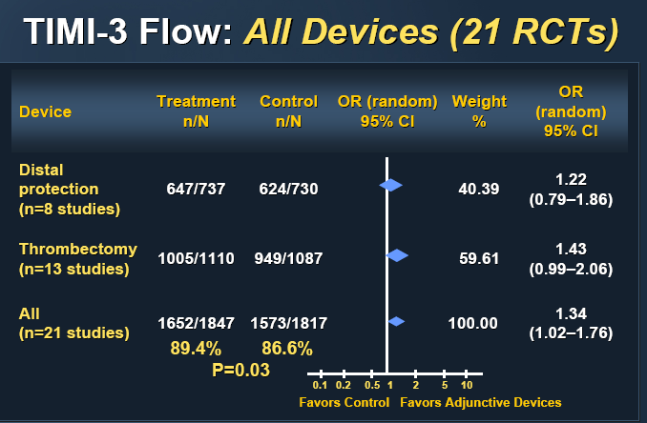
Distal Embolisation

Slide 37
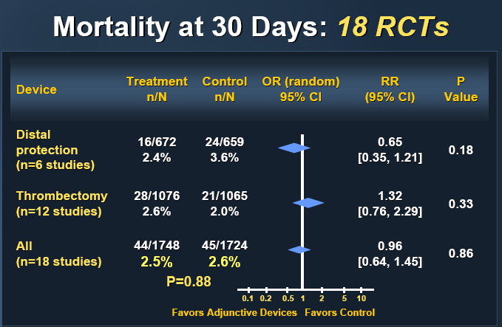
Distal Embolisation

Slide 38
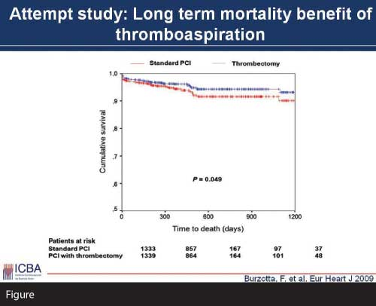
Distal Embolisation

Slide 39
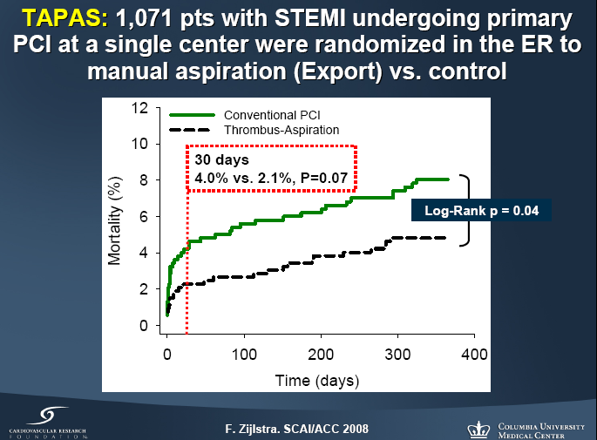
Distal Embolisation

Slide 40
Acute Coronary Syndrome
Therapeutic goal
Inhibit platelet aggregation and stabilize plaque to prevent progression of thrombosis
No ST-Elevation

Slide 41
First risk accessment in ACS pts
Does this patient have symptoms due to acute ischemia from obstructive CAD?
What is the likelihood of death, MI, heart failure?

Slide 42
Risk Scores
 | TIMI | GRACE | Future
History | Age Hypertension Diabetes Smoking ↑cholesterol Family history History of CAD | Age | Continuous assessment
Presentaiton | Severe angina Aspirin within 7 days Elevated markers ST segment deviation | Heart rate Systolic BP Elevated markers Heart failure Cardiac arrest Elevated markers ST segment deviation | New markers Electronic health records

Slide 43
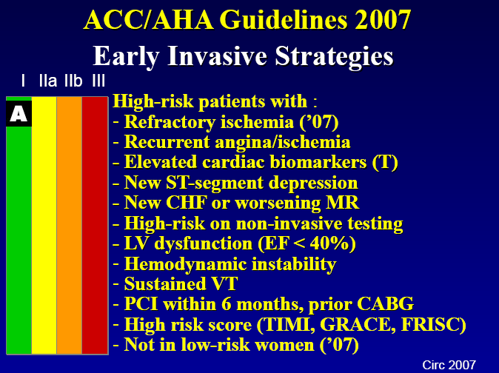

Slide 44


Slide 45
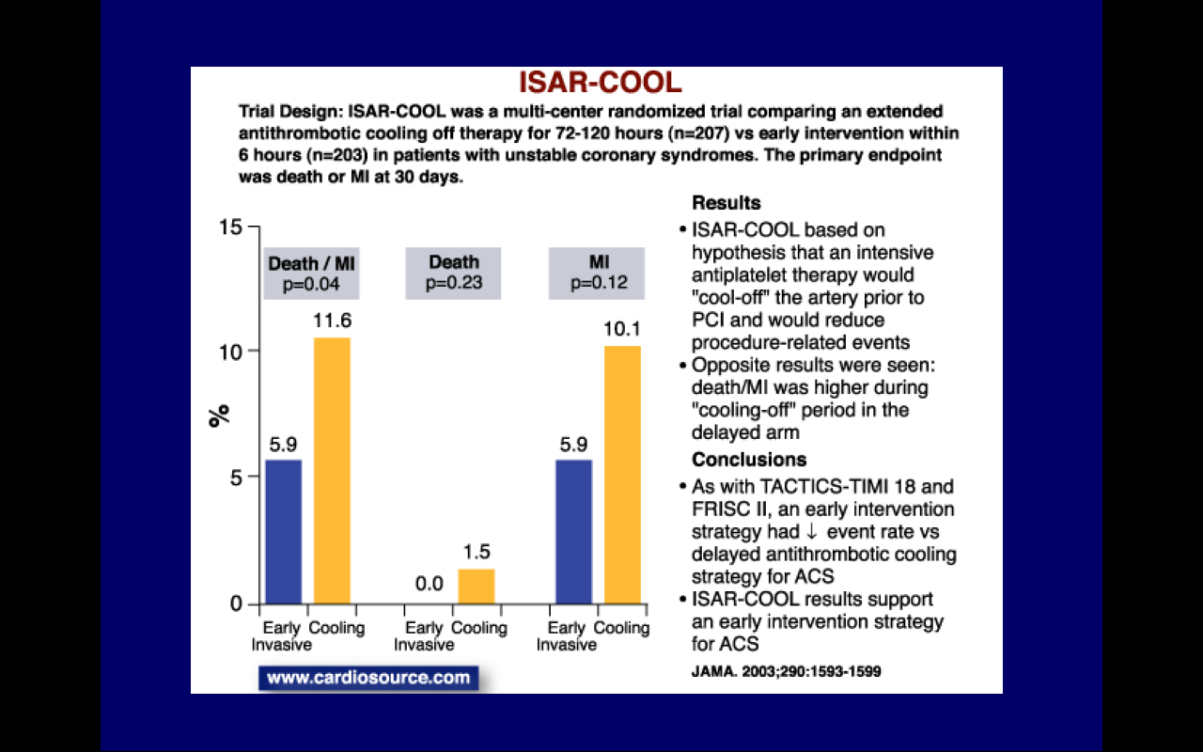
How Early?

Slide 46
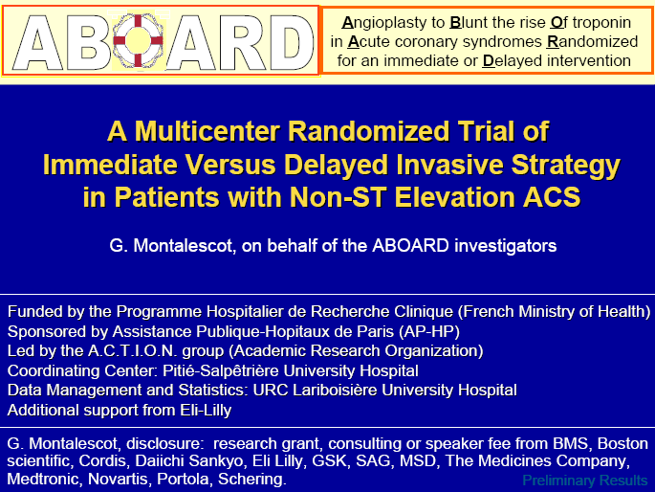
How Early?

Slide 47
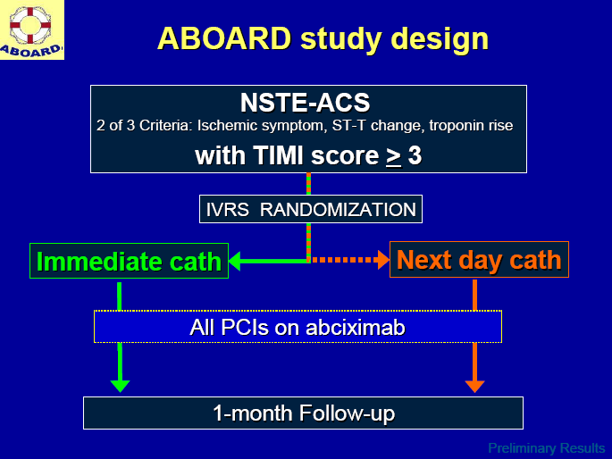
How Early?

Slide 48
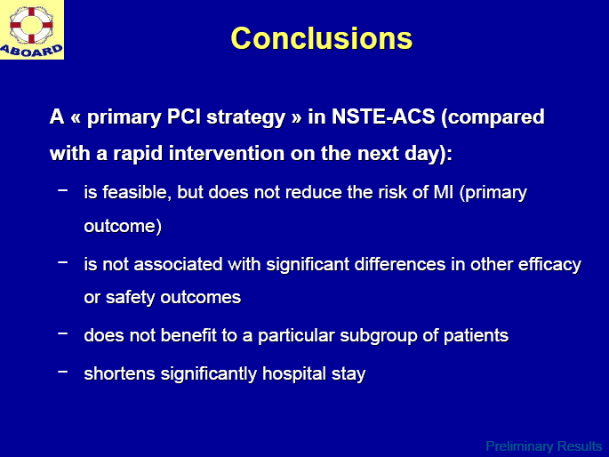
How Early?

Slide 49
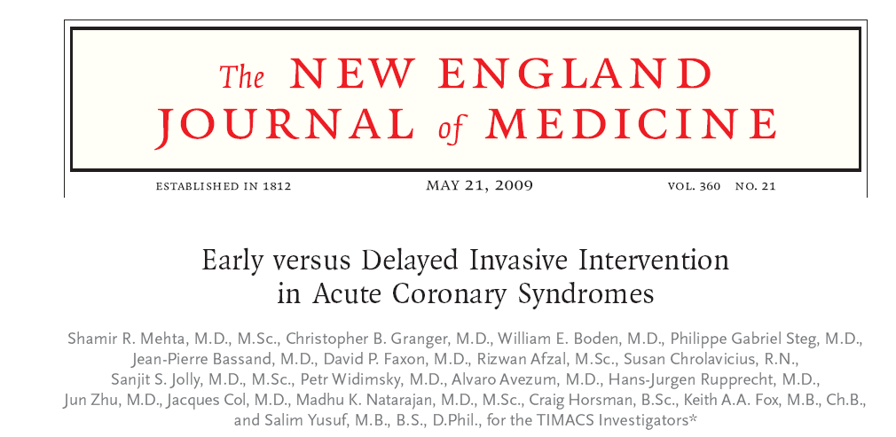
How Early?
< 24 h
> 36 h

Slide 50

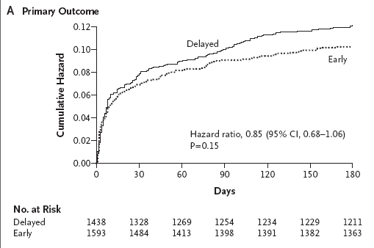
6 months death, MI, stroke

Slide 51
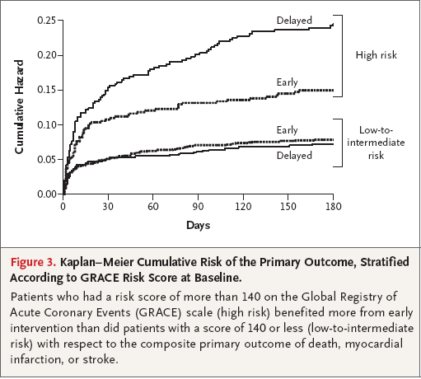

Slide 52
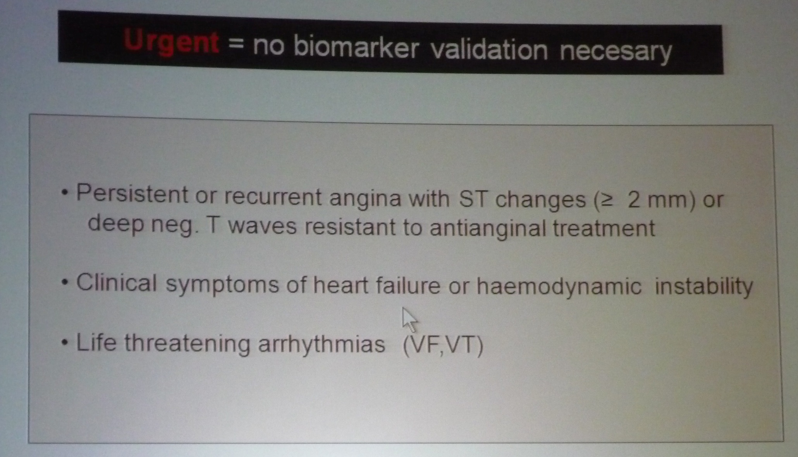
How Early?
Urgent= no biomarker validation necessary

Slide 53
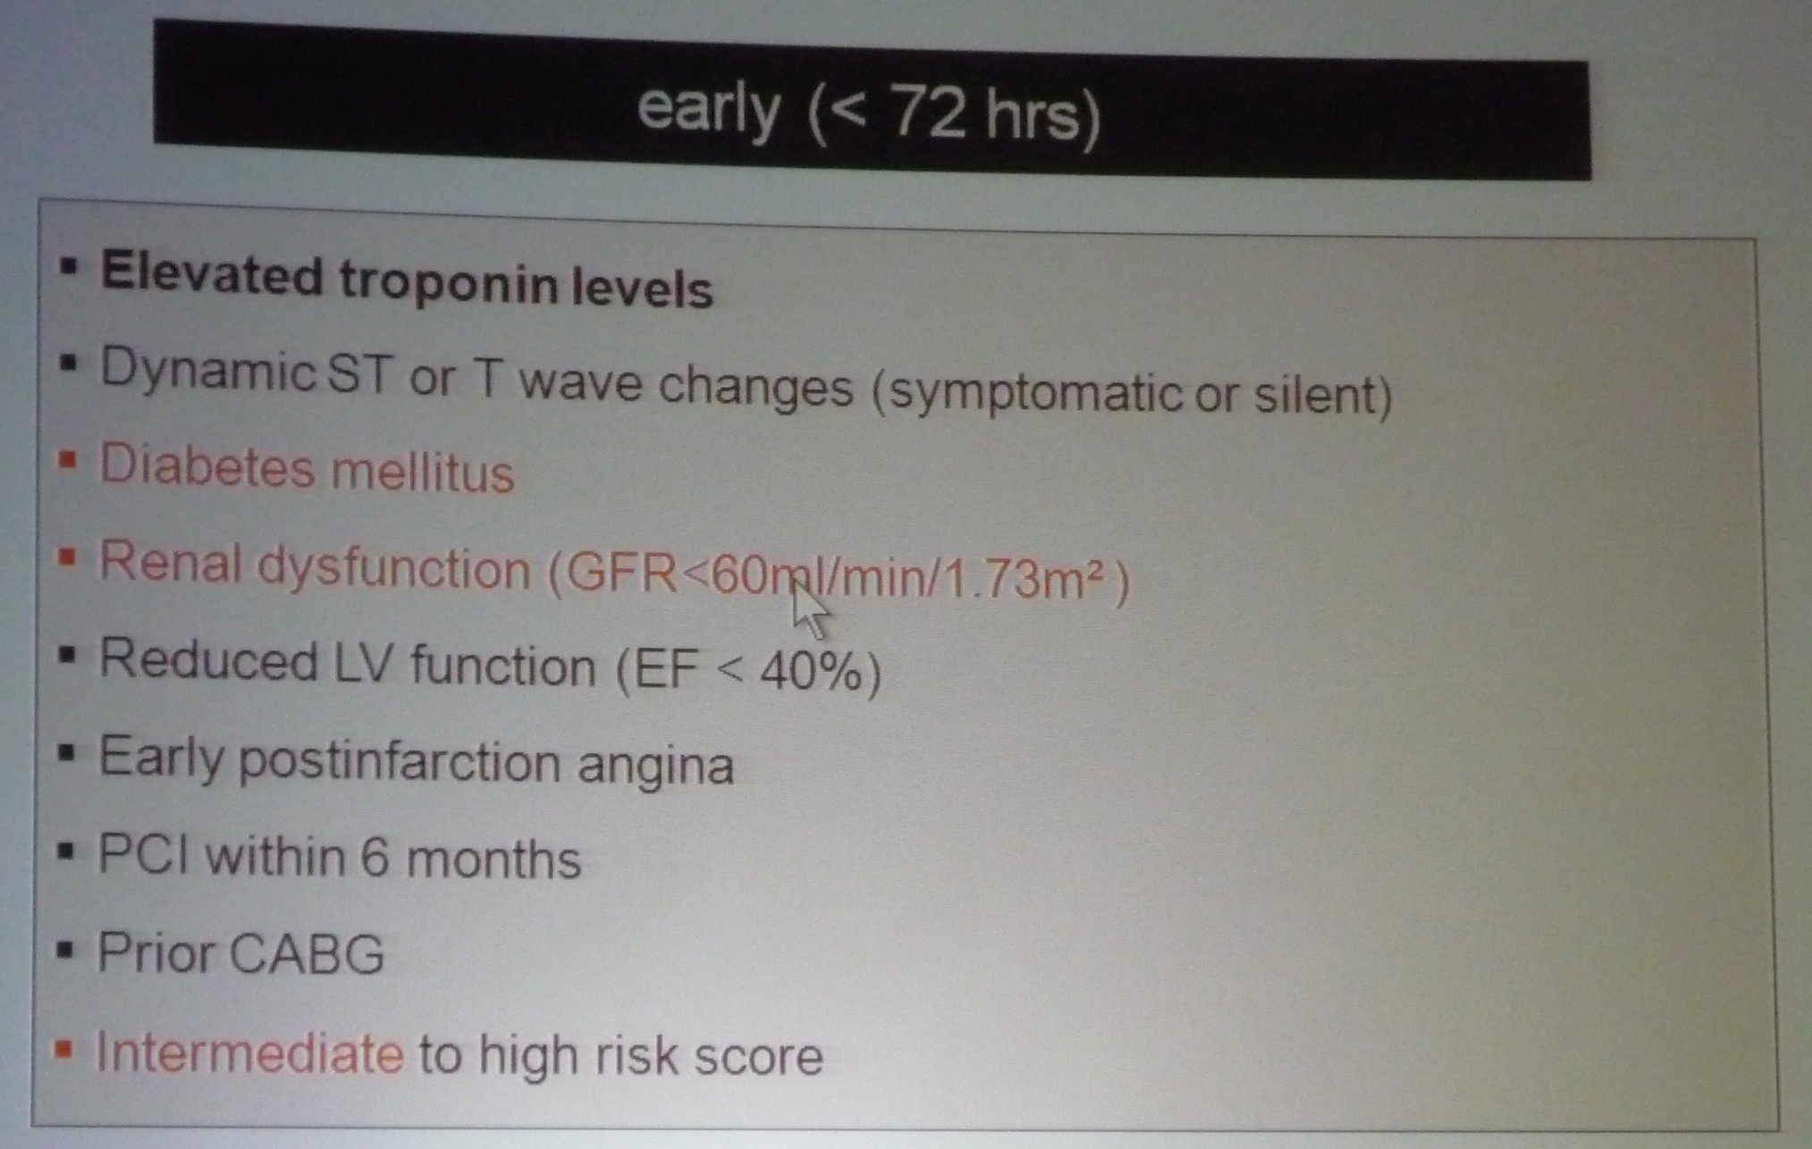
How Early?
Early < 72 hours

Slide 54
Antiplatelet Therapy in ACS
I
I
I
IIa
For UA/NSTEMI patients in whom an initial invasive strategy is selected, antiplatelet therapy in addition to ASA should be initiated before diagnostic angiography (upstream) with either clopidogrel (loading dose followed by daily maintenance dose)* or an IV GP IIb/IIIa inhibitor. (Box B2)
Abciximab as the choice for upstream GP IIb/IIIa therapy is indicated only if there is no appreciable delay to angiography and PCI is likely to be performed; otherwise, IV eptifibatide or tirofiban is the preferred choice of GP IIb/IIIa inhibitor.†
IIa
IIa
IIa
IIb
IIb
IIb
IIb
III
III
III
I
III
I
I
IIa
IIa
IIa
IIa
IIb
IIb
IIb
IIb
III
III
III
I
III
I
I
IIa
IIa
IIa
IIa
IIb
IIb
IIb
IIb
III
III
III
III
A
I
I
I
IIa
IIa
IIa
IIa
IIb
IIb
IIb
IIb
III
III
III
I
III
I
I
IIa
IIa
IIa
IIa
IIb
IIb
IIb
IIb
III
III
III
I
III
I
I
IIa
IIa
IIa
IIa
IIb
IIb
IIb
IIb
III
III
III
III
B
*Some uncertainty exists about optimum dosing of clopidogrel. Randomized trials establishing its efficacy and providing data on bleeding risks used a loading dose of 300 mg orally followed by a daily oral maintenance dose of 75 mg. Higher oral loading doses such as 600 or 900 mg of clopidogrel more rapidly inhibit platelet aggregation and achieve a higher absolute level of inhibition of platelet aggregation, but the additive clinical efficacy and the safety of higher oral loading doses have not been rigorously established; †Factors favoring administration of both clopidogrel and a GP IIb/IIIa inhibitor include: delay to angiography, high-risk features, and early ischemic discomfort.

Slide 55
Antiplatelet Therapy in ACS
I
For UA/NSTEMI patients in whom an initial invasive strategy is selected, it is reasonable to initiate antiplatelet therapy with both clopidogrel (loading dose followed by daily maintenance dose)* and an intravenous GP IIb/IIIa inhibitor. (Box B2)
Abciximab as the choice for upstream GP IIb/IIIa therapy is indicated only if there is no appreciable delay to angiography and PCI is likely to be performed; otherwise, IV eptifibatide or tirofiban is the preferred choice of GP IIb/IIIa inhibitor.†
I
I
IIa
IIa
IIa
IIa
IIb
IIb
IIb
IIb
III
III
III
I
III
I
I
IIa
IIa
IIa
IIa
IIb
IIb
IIb
IIb
III
III
III
I
III
I
I
IIa
IIa
IIa
IIa
IIb
IIb
IIb
IIb
III
III
III
III
B
I
I
I
IIa
IIa
IIa
IIa
IIb
IIb
IIb
IIb
III
III
III
I
III
I
I
IIa
IIa
IIa
IIa
IIb
IIb
IIb
IIb
III
III
III
I
III
I
I
IIa
IIa
IIa
IIa
IIb
IIb
IIb
IIb
III
III
III
III
B
*Some uncertainty exists about optimum dosing of clopidogrel. Randomized trials establishing its efficacy and providing data on bleeding risks used a loading dose of 300 mg orally followed by a daily oral maintenance dose of 75 mg. Higher oral loading doses such as 600 or 900 mg of clopidogrel more rapidly inhibit platelet aggregation and achieve a higher absolute level of inhibition of platelet aggregation, but the additive clinical efficacy and the safety of higher oral loading doses have not been rigorously established; †Factors favoring administration of both clopidogrel and a GP IIb/IIIa inhibitor include: delay to angiography, high-risk features, and early ischemic discomfort.

Slide 56
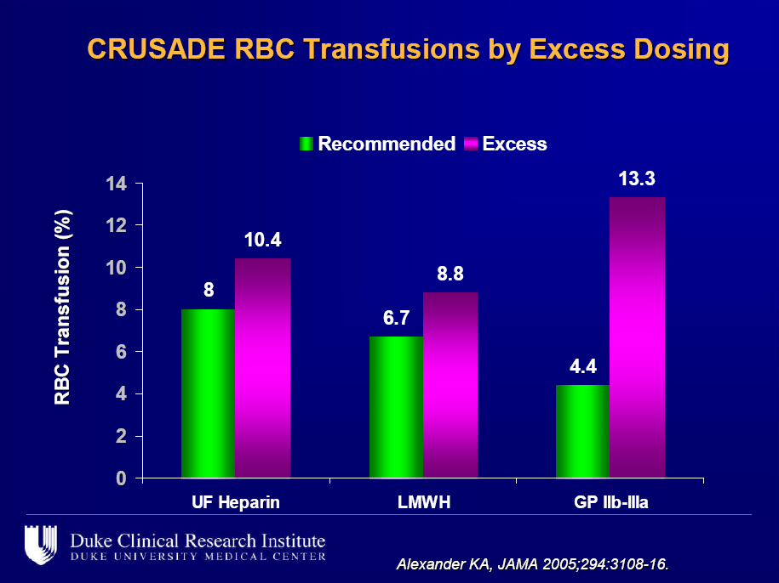
Antiplatelet Therapy in ACS

Slide 57
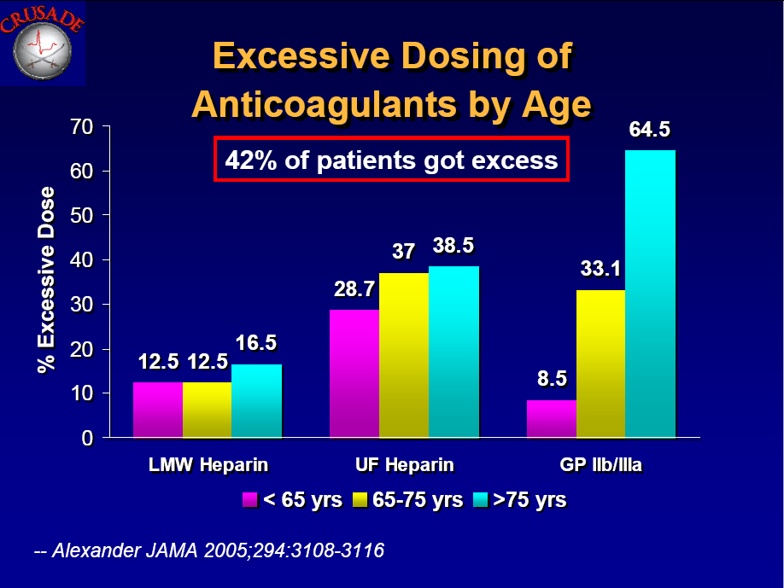
Antiplatelet Therapy in ACS

Slide 58
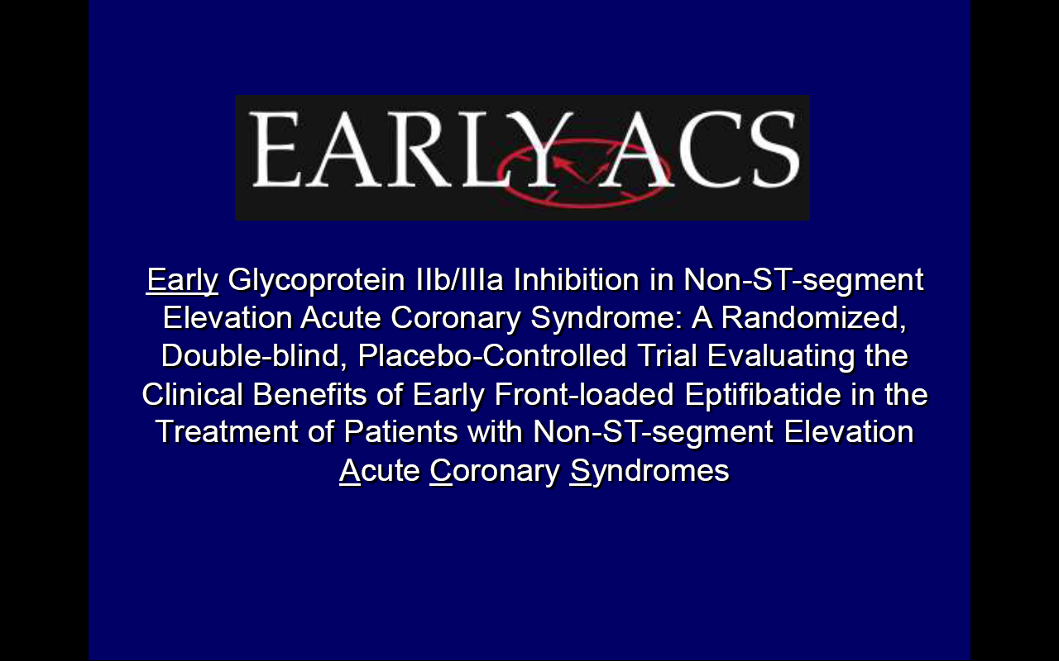
Antiplatelet Therapy in ACS
TCT, september 2009

Slide 59
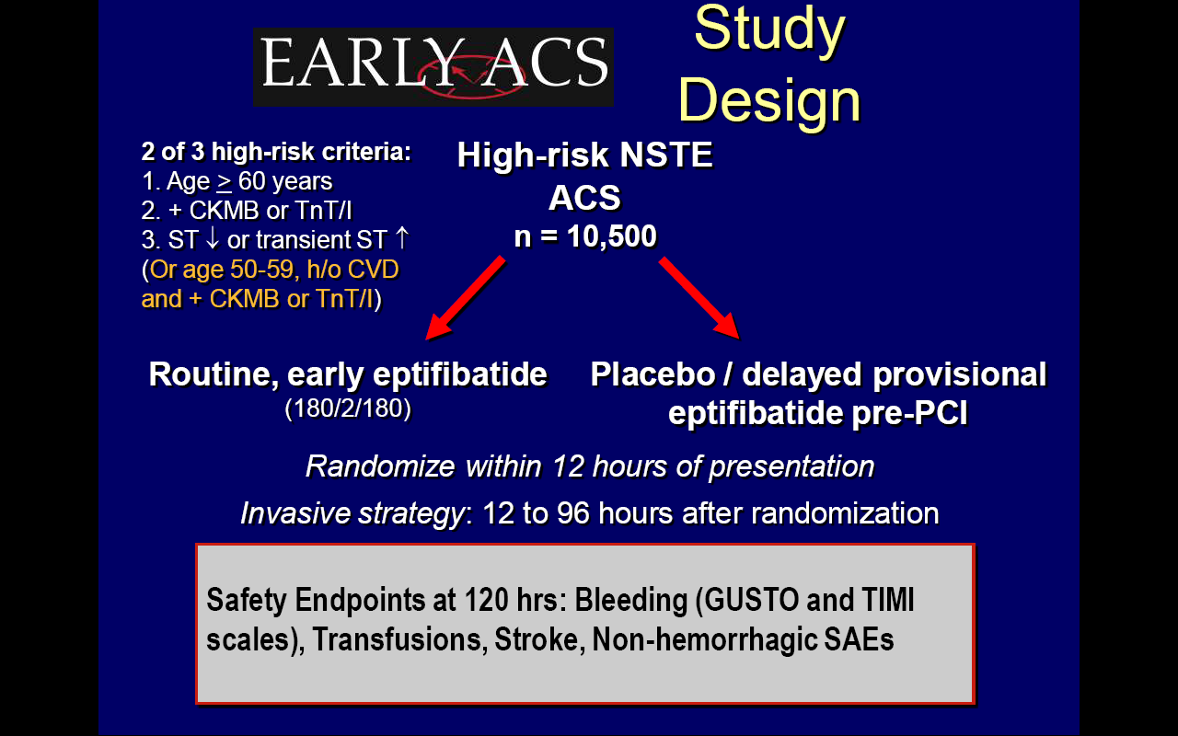
Antiplatelet Therapy in ACS

Slide 60
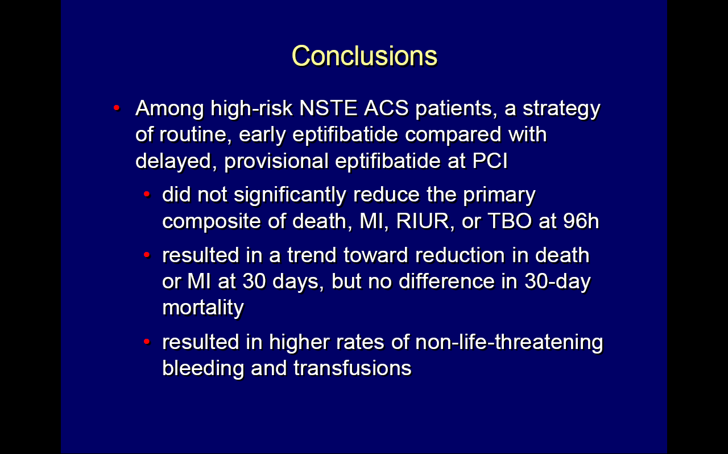
Antiplatelet Therapy in ACS
TCT, september 2009

Slide 61
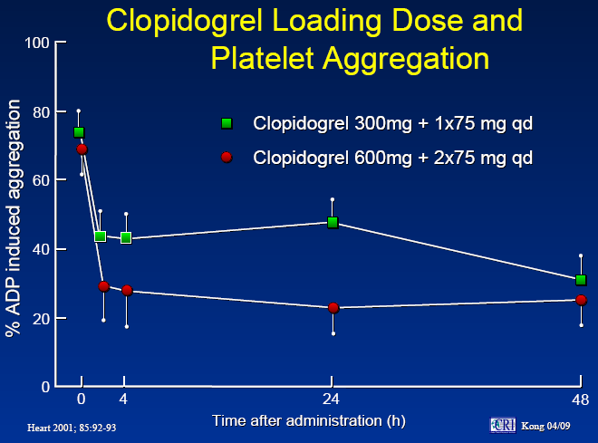
Antiplatelet Therapy in ACS

Slide 62
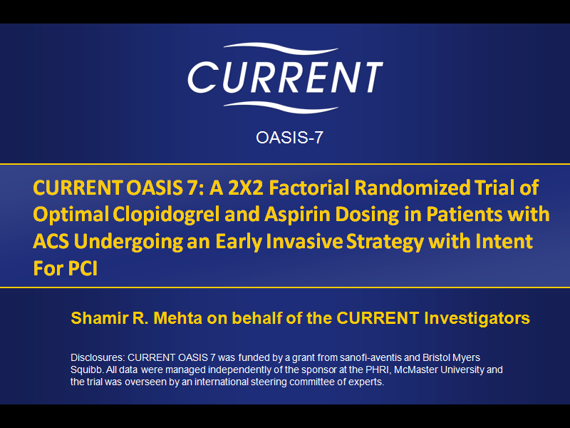
Antiplatelet Therapy in ACS
TCT, september 2009

Slide 63
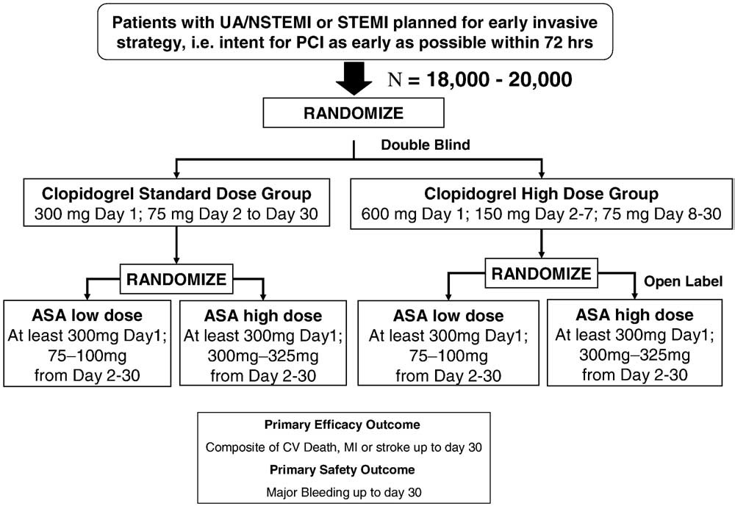
Antiplatelet Therapy in ACS

Slide 64
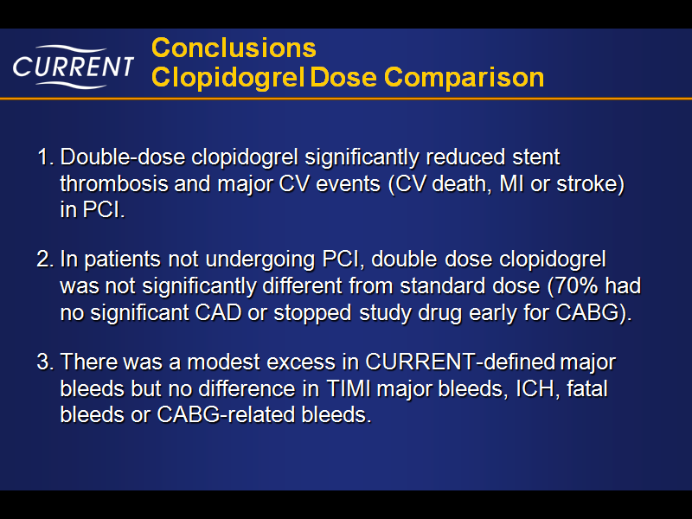
Antiplatelet Therapy in ACS
TCT, september 2009

Slide 65
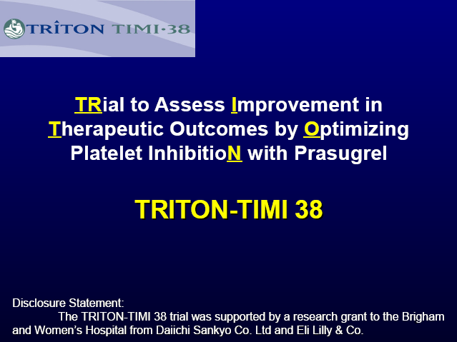
Antiplatelet Therapy in ACS: New Drugs

Slide 66
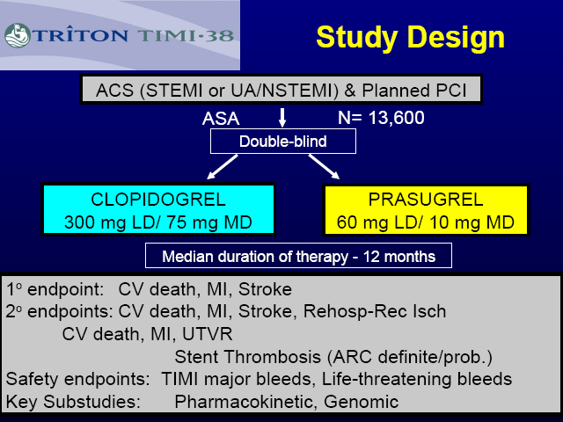
Antiplatelet Therapy in ACS: New Drugs

Slide 67
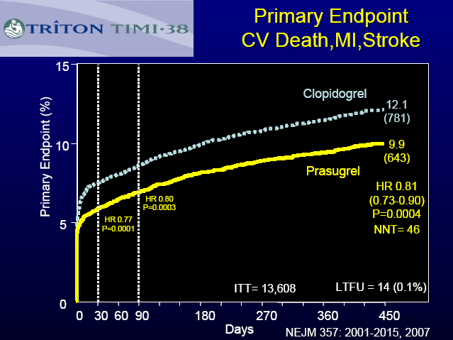
Antiplatelet Therapy in ACS: New Drugs

Slide 68

Antiplatelet Therapy in ACS: New Drugs

Slide 69

Antiplatelet Therapy in ACS: New Drugs

Slide 70

Antiplatelet Therapy in ACS: New Drugs

Slide 71

Antiplatelet Therapy in ACS: New Drugs

Slide 72

Antiplatelet Therapy in ACS: New Drugs

Slide 73
ACS Interventional Trends 2009
Benefit greatest among highest risk patients
In STEMI pts immediate PCI is the true aswer!!
In NSTEMI pts urgent PCI (primary-PCI like) in very high risk pts; in the others a cooling off therapy for 24-72 hrs is better
Anti-platelet therapy in fundamental to PCI success, but a systematic use of Gp 2a-3b receptor blockade is not necessary
Determining the balance of thrombotic risk and bleeding complication require careful thought

Slide 74

New Antiplatelet agents

Slide 75
Ticagrelor compared with clopidogrel in patients with acute coronary syndromes – the PLATelet Inhibition and patient Outcomes trial
Invasive
Outcomes in patients with a Planned Invasive Strategy
The PLATO trial was funded by AstraZeneca
Dr. Cannon discloses research grants/support from the following companies: Accumetrics, AstraZeneca, Bristol-Myers Squibb/Sanofi Partnership, GlaxoSmithKline, Intekrin Therapeutics, Merck, Merck/Schering Plough Partnership, Novartis and Takeda; and equity in Automedics Medical Systems

Slide 76


Slide 77


Slide 78


Slide 79


Slide 80
Ischemic Discomfort
Acute Coronary Syndrome
Presentation
Working Dx
ECG
No ST Elevation
ST Elevation
Non-ST ACS
Cardiac
Biomarker
UA
NSTEMI
Unstable
Angina
Myocardial Infarction
Final Dx
NQMI
Qw MI
Libby P. Circulation 2001;104:365, Hamm CW, Bertrand M, Braunwald E, Lancet 2001; 358:1533-1538; Davies MJ. Heart 2000; 83:361-366.
Anderson JL, et al. J Am Coll Cardiol. 2007;50:e1-e157, Figure 1. Reprinted with permission.

Slide 81

CURRENT OASIS 7 TRIAL
Trial design: Patients presenting with ACS were randomized in a 2 x 2 factorial design to either low-dose or high-dose aspirin, and standard-dose or high-dose clopidogrel. Patients were followed for 30 days.
Results
No difference in primary endpoint between aspirin arms; benefit noted in high-dose arm on high-dose clopidogrel (p = 0.04)
No difference in primary endpoint between clopidogrel arms, but significant interaction with aspirin dose; benefit noted in high-dose arm undergoing PCI (p < 0.05)
Major bleeding similar in both aspirin arms, but higher in high-dose clopidogrel arm (p = 0.01)
30
(p = 0.76)
30
(p = 0.37)
20
20
%
%
10
10
4.4
4.2
4.4
4.2
Conclusions
0
0
High-dose aspirin and high-dose clopidogrel associated with significant clinical benefit at 30 days in ACS patients; more in PCI subgroup
Bleeding complications were higher with high-dose clopidogrel, but not with aspirin
Important findings; likely to be in future guidelines
Primary endpoint (CV death, MI, stroke)
ASA 300-325 mg
Standard-dose clopidogrel
ASA 75-100 mg
High-dose clopidogrel
Presented by Dr. Shamir Mehta at ESC 2009

Slide 82
First risk assessment in ACS pts
Likelihood of obstructive CAD as cause of symptoms
  Dominated by acute findings
    Exam
    Symptoms
    Markers
  Evaluation of traditional risk factors is important
Does this patient have symptoms due to acute ischemia from obstructive CAD?
Risk of bad outcome
  Dominated by acute findings
    Older age very important
    Hemodynamic abnormalities critical
    ECG, markers
What is the likelihood of death, MI, heart failure?

Slide 83

Anticoagulant Therapy in ACS

Slide 84

Anticoagulant Therapy in ACS

Slide 85


Slide 86


Slide 87


Slide 88


Slide 89


Slide 90


Slide 91


Slide 92


Slide 93


Slide 94


Slide 97


Slide 98


Slide 99


Slide 101

Distal Embolisation

